Slide 1



MCSE 666:
Pattern and Speech Recognition
Aspect & Prospect
Dr. Md. Aminul Haque Akhand Dept. of CSE, SUB

Slide 2
PG Course: Instructor vs. Student Qualification and Contribution
2
PhD
MSc
UG
Instructor
Instructor
HSC
SSC
PSC
PSC SSC HSC
UG MSc
Student
Student
Qualification
Contribution

Slide 3

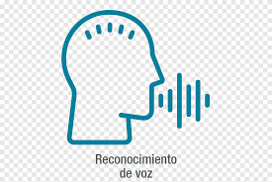
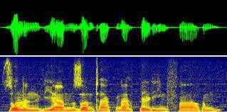
Pattern and Speech Recognition (PSR)
3
Pattern
Speech Recognition

Slide 4
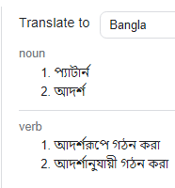
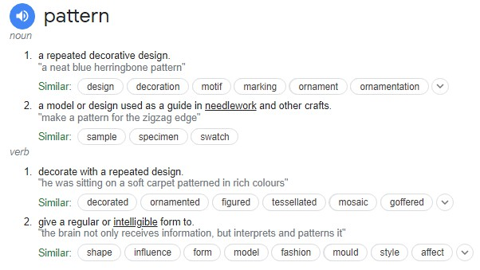
PSR Individual Terms: Pattern
4

Slide 5
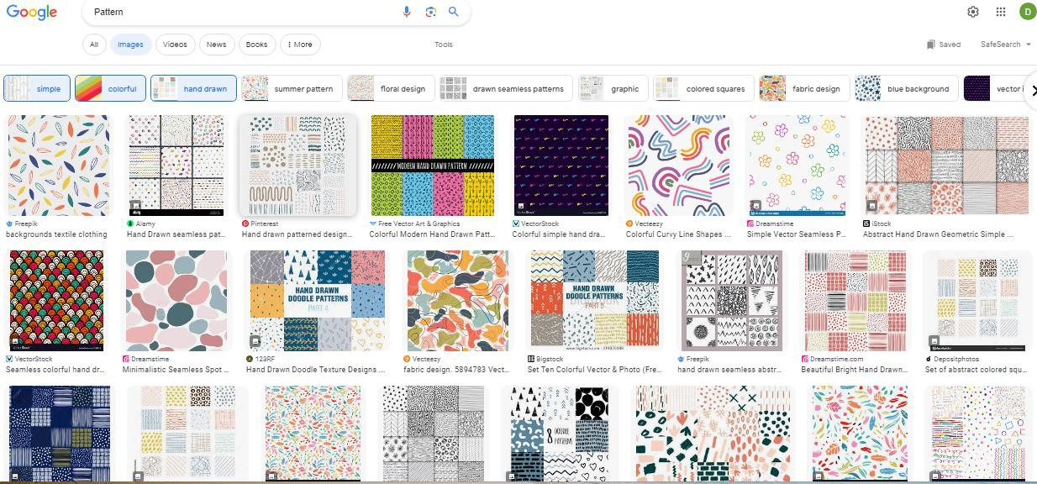
PSR Individual Terms: Pattern
5
A pattern is a regularity in the world, in human-made design, or in abstract ideas. The elements of a pattern repeat in a predictable manner. A geometric pattern is a kind of pattern formed of geometric shapes and typically repeated like a wallpaper design.

Slide 6
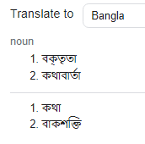
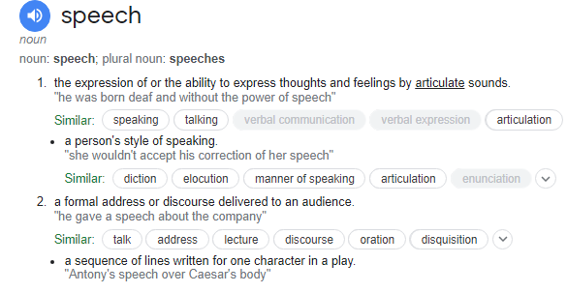
PSR Individual Terms: Speech
6

Slide 7

PSR Individual Terms: Speech
7
Speech, language refer to the means of communication used by people. Speech is the expression of ideas and thoughts by means of articulate vocal sounds, or the faculty of thus expressing ideas and thoughts.

Slide 8
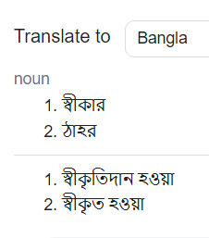
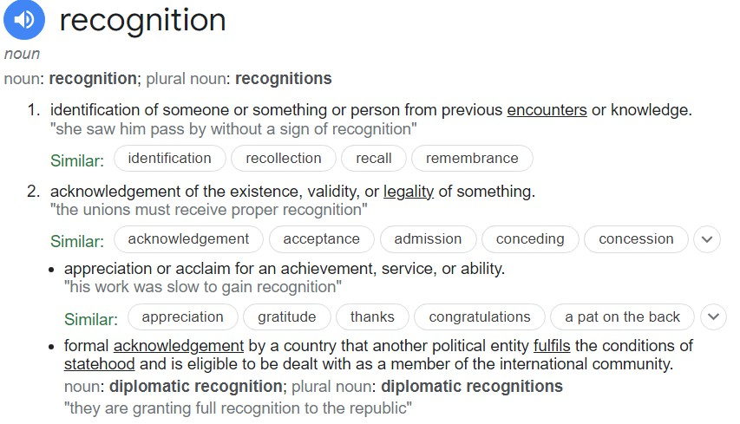
PSR Individual Terms: Recognition
8

Slide 9

PSR Individual Terms: Recognition
9
Recognition in sociology is the public acknowledgment of a person's status or merits (achievements, virtues, service, etc.).
Another example of recognition is when some person is accorded some special status, such as title or classification.

Slide 10
Pattern and Speech Recognition (PSR)
10
Pattern Speech Recognition
Speech Pattern Recognition
Pattern Recognition and
Speech Recognition
Intelligent Pattern Recognition and
Intelligent Speech Recognition

Slide 11
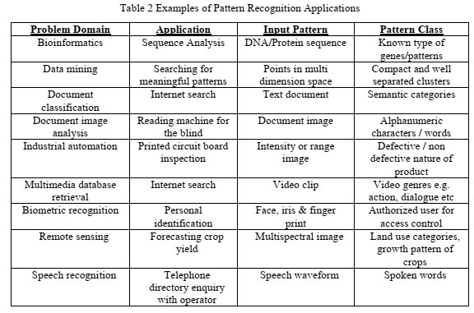
Examples of Pattern Recognition
11
Mayank Parasher et al., Anatomy on Pattern Recognition, June 2011, Indian Journal of Computer Science and Engineering 2(3)

Slide 12
Examples of Pattern Recognition
12
What Are the Real-World Applications of Pattern Recognition?
https://serokell.io/blog/applications-of-pattern-recognition
10 Real Life Examples Of Pattern Recognition
https://numberdyslexia.com/pattern-recognition-real-life-examples/
Pattern recognition and use in real life problem solving
https://suresolv.com/problem-solving-techniques/pattern-recognition-and-use- real-life-problem-solving
What is pattern recognition and why it matters? Definitive guide
https://theappsolutions.com/blog/development/pattern-recognition-guide/

Slide 13
MCSE 666: Pattern and Speech Recognition
13
SUB MCSE 666 Syllabus or Course Outline
Introduction to formal languages and patterns; string languages for pattern description; higher dimensional pattern grammars; syntax analysis as a recognition procedure; stochastic languages; error correcting parsing for string languages; error-correcting tree automata; cluster analysis for syntactic patterns; grammatical inference for syntactic pattern recognition; syntactic approach to texture analysis;
Speech signal: production, perception and characterization; signal analysis; pattern comparison techniques: distortion
processing and
measures, spectral-distortion measures, time alignment and normalization; recognition system design and implementation: source-coding, template training, and performance analysis; connected word models; continuous speech recognition: sub word units, statistical modeling, and context- dependent units; task oriented models.

Slide 14
Textbooks
14

Slide 15
Open Discussion on Course Conduction
15

Slide 16
Introduction to Pattern Recognition
MCSE 666:Pattern and Speech Recognition
Dr. Md. Aminul Haque Akhand Dept. of CSE, SUB

Slide 17
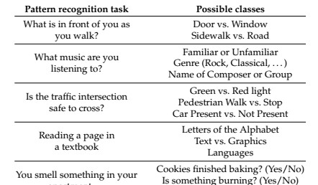
What Is Pattern Recognition?
2
Pattern recognition (PR) is a process by which some input is measured, analyzed, and then classified as belonging to one of a set of classes
Process of PR and classification is a continual, never ending
aspect of every-day human existence:

Slide 18
What Is Pattern Recognition? Cont.
3
PR as a human experience refers to a perceptual process: some form of sensory input is sensed, analyzed, and recognized (classified), either subconsciously (by instinct) or consciously (based on previous experience).
Patterns may be presented in any sensory modality: vision, hearing, touch, taste, or smell.
PR as a technical discipline: a process in which an input object is measured, analyzed, and classified by a machine as being more or less similar to some class in a set of classes.

Slide 19
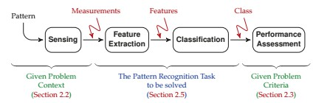
Pattern Recognition Framework
4
The goal of PR is to provide a machine with a kind of perceptual capability to automatically extract useful information from measured data.

Slide 20
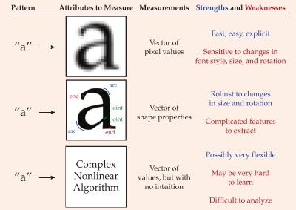
5
PR Illustration with Example
Pattern Recognition of Text

Slide 21
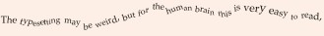
PR Illustration with Example
6
Pattern Recognition of the Mind
It deons’t mettar in waht oerdr the lrttees in a wrod are, as lnog as the frist and lsat ltteres rmeain in the rgiht pacle.
The retina in the eye is densely packed with light-sensitive cells, so that it may be tempting to think
Our brain effectively sees and perceives the world as a great many pixels.
There are many simple mind tricks or optical illusions

Slide 22
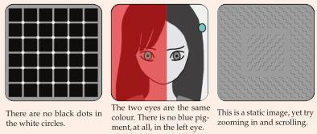
PR Illustration with Example
7
Pattern Recognition of the Mind
The eye is not just sending pixellated images to the brain.
There is a great deal of feature extraction taking place, much already in the retina
It is very helpful in running through a forest, but perhaps not so useful in staring at deliberately manipulated images on a page.

Slide 23
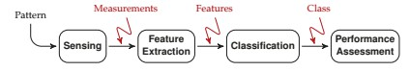
Features from Patterns
8
The word “pattern” may bring to mind texture, fabric, or shape.
In the context of pattern recognition, the notion of pattern is far more broad, and can apply to any thing that can be distinguished from another thing.
Identity view point: infer the unknown identity of an object
Type of wildflower, type of songbird, or the name of the person facing a camera — each of these has a certain identity to determine from measurements.
A pattern is assumed to have certain properties or
attributes which distinguishes it from other patterns.

Slide 24
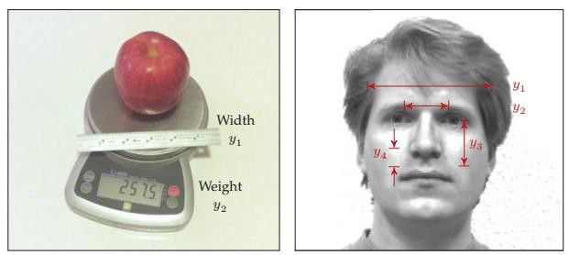
Features from Patterns (Cont.)
9
One or more measurements are taken of a pattern
Size / weight of a piece
Various dimensions from face
Does all measurements from patterns important to distinguish?

Slide 25
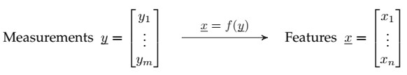
Features from Patterns (Cont.)
10
The selection of appropriate measurements is an essential
Measurements may cost money and/or time, and
Poor measurements lead to poor performance of the resulting classifier.
The process of transforming measurements into features facilitate classification, normally in one or both of the following ways:
By reducing the dimensionality of the problem: n < m
By creating
features in which patterns are more clearly
distinguished.

Slide 26
Features from Patterns (Cont.)
11
The feature extraction function f() can focus the information from x, or it can remove irrelevant information from x, but f() never adds information.
Data Processing Theorem: x can never have more
information than was present in y.
An effective feature extraction function f() can make the PR problem easier,
However, in principle, the best possible classifier based on the measurements y should perform at least as well as the best possible classifier based on the features x.

Slide 27
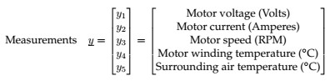
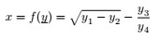
Features from Patterns (Cont.)
12
Features may be intuitive or they may be quite abstract.
Consider, the measurements of an electric motor:
Power as Feature: Understandable
Uninterpretable feature do not
make any physical sense,
But perhaps be effective as a feature for classification.

Slide 28
Classes and Classification
13
The whole purpose of PR or classification consists of
assigning an object to a class.
A class is a particular pattern, or possibly a group of patterns which are similar or equivalent in some sense.
In a given problem, the set of classes C is defined as
C = {C₁; C₂; -; -; -; -; C_{K} };
Have to choose one class from K different classes.
Members of a class share some common properties or attributes
In PR problems the class set C is predefined and has been specified as part of the problem to be solved.

Slide 29
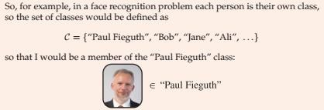
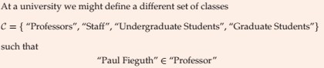
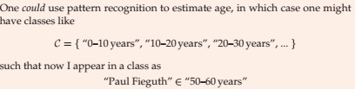
Classes and Classification
14

Slide 30
Classes and Classification
15
Way of Describing Classes
Via Prototype Idealized representation or notion of the “essence” of the class. Pros: each class is unambiguously defined, Cons: no scope for variability.
Via Parameterized Shape: A generalization of the prototype; the class has a known shape (e.g., rectangular or elliptical), the shape is described in some number of parameters (e.g., ellipse centre, rotation, and axis lengths). Pros. more flexible than that of a single prototype, Cons: still requires the type of shape to be assumed or known.
Via Statistical Distribution: Some description of the likelihood or probability of a class member having a particular set of measurements or features. Pros.: very comprehensive, Cons: There will be circumstances when the statistics are not known and may be difficult to infer.
Via Samples: A set of given samples (many apples, or tigers, or bicycles) directly characterizes the class. Pros: Highly convenient, since nothing further needs to be done to describe the class Cons: Storage and computational challenges, since all of the data need to be saved.

Slide 31
Classes and Classification
16
Variability in a Class
Patterns do not need to be identical to belong to the same class: not all pictures of a person the same, or of tigers, or of apples.
There are at least two sources of variability present in the measurements associated with a single class:
The inherent variability within a class: Every class will consist of members which differ in some way. The degree and nature of the inherent variability will depend greatly on the class definition.
“Fruit” class contains all manners of variability in colour, size, and shape; “Apple” class is much more specific, but apples do come in different colours and patterning; the “Granny Smith Apple” class is even more specific, but still will have apples of different sizes or with more or fewer blemishes.
Noise or random variations in measurement: Every measurement
involves some sort of physical process which will be subject to error, such as thermal noise in electronics, or quantization noise in converting an analogue signal to a digital representation.

Slide 32
Open Discussion on Course Conduction
17

Slide 33
Introduction to Pattern Recognition
MCSE 666:Pattern and Speech Recognition
Dr. Md. Aminul Haque Akhand Dept. of CSE, SUB

Slide 34
What Is Pattern Recognition?
2
Pattern recognition (PR) is a process by which some input is measured, analyzed, and then classified as belonging to one of a set of classes
Process of PR and classification is a continual, never ending
aspect of every-day human existence:

Slide 35
What Is Pattern Recognition? Cont.
3
PR as a human experience refers to a perceptual process: some form of sensory input is sensed, analyzed, and recognized (classified), either subconsciously (by instinct) or consciously (based on previous experience).
Patterns may be presented in any sensory modality: vision, hearing, touch, taste, or smell.
PR as a technical discipline: a process in which an input object is measured, analyzed, and classified by a machine as being more or less similar to some class in a set of classes.

Slide 36
Pattern Recognition Framework
4
The goal of PR is to provide a machine with a kind of perceptual capability to automatically extract useful information from measured data.

Slide 37
5
PR Illustration with Example
Pattern Recognition of Text

Slide 38
PR Illustration with Example
6
Pattern Recognition of the Mind
It deons’t mettar in waht oerdr the lrttees in a wrod are, as lnog as the frist and lsat ltteres rmeain in the rgiht pacle.
The retina in the eye is densely packed with light-sensitive cells, so that it may be tempting to think
Our brain effectively sees and perceives the world as a great many pixels.
There are many simple mind tricks or optical illusions

Slide 39
PR Illustration with Example
7
Pattern Recognition of the Mind
The eye is not just sending pixellated images to the brain.
There is a great deal of feature extraction taking place, much already in the retina
It is very helpful in running through a forest, but perhaps not so useful in staring at deliberately manipulated images on a page.

Slide 40
Features from Patterns
8
The word “pattern” may bring to mind texture, fabric, or shape.
In the context of pattern recognition, the notion of pattern is far more broad, and can apply to any thing that can be distinguished from another thing.
Identity view point: infer the unknown identity of an object
Type of wildflower, type of songbird, or the name of the person facing a camera — each of these has a certain identity to determine from measurements.
A pattern is assumed to have certain properties or
attributes which distinguishes it from other patterns.

Slide 41
Features from Patterns (Cont.)
9
One or more measurements are taken of a pattern
Size / weight of a piece
Various dimensions from face
Does all measurements from patterns important to distinguish?

Slide 42
Features from Patterns (Cont.)
10
The selection of appropriate measurements is an essential
Measurements may cost money and/or time, and
Poor measurements lead to poor performance of the resulting classifier.
The process of transforming measurements into features facilitate classification, normally in one or both of the following ways:
By reducing the dimensionality of the problem: n < m
By creating
features in which patterns are more clearly
distinguished.

Slide 43
Features from Patterns (Cont.)
11
The feature extraction function f() can focus the information from x, or it can remove irrelevant information from x, but f() never adds information.
Data Processing Theorem: x can never have more
information than was present in y.
An effective feature extraction function f() can make the PR problem easier,
However, in principle, the best possible classifier based on the measurements y should perform at least as well as the best possible classifier based on the features x.

Slide 44
Features from Patterns (Cont.)
12
Features may be intuitive or they may be quite abstract.
Consider, the measurements of an electric motor:
Power as Feature: Understandable
Uninterpretable feature do not
make any physical sense,
But perhaps be effective as a feature for classification.

Slide 45
Classes and Classification
13
The whole purpose of PR or classification consists of
assigning an object to a class.
A class is a particular pattern, or possibly a group of patterns which are similar or equivalent in some sense.
In a given problem, the set of classes C is defined as
C = {C₁; C₂; -; -; -; -; C_{K} };
Have to choose one class from K different classes.
Members of a class share some common properties or attributes
In PR problems the class set C is predefined and has been specified as part of the problem to be solved.

Slide 46
Classes and Classification
14

Slide 47
Classes and Classification
15
Way of Describing Classes
Via Prototype Idealized representation or notion of the “essence” of the class. Pros: each class is unambiguously defined, Cons: no scope for variability.
Via Parameterized Shape: A generalization of the prototype; the class has a known shape (e.g., rectangular or elliptical), the shape is described in some number of parameters (e.g., ellipse centre, rotation, and axis lengths). Pros. more flexible than that of a single prototype, Cons: still requires the type of shape to be assumed or known.
Via Statistical Distribution: Some description of the likelihood or probability of a class member having a particular set of measurements or features. Pros.: very comprehensive, Cons: There will be circumstances when the statistics are not known and may be difficult to infer.
Via Samples: A set of given samples (many apples, or tigers, or bicycles) directly characterizes the class. Pros: Highly convenient, since nothing further needs to be done to describe the class Cons: Storage and computational challenges, since all of the data need to be saved.

Slide 48
Classes and Classification
16
Variability in a Class
Patterns do not need to be identical to belong to the same class: not all pictures of a person the same, or of tigers, or of apples.
There are at least two sources of variability present in the measurements associated with a single class:
The inherent variability within a class: Every class will consist of members which differ in some way. The degree and nature of the inherent variability will depend greatly on the class definition.
“Fruit” class contains all manners of variability in colour, size, and shape; “Apple” class is much more specific, but apples do come in different colours and patterning; the “Granny Smith Apple” class is even more specific, but still will have apples of different sizes or with more or fewer blemishes.
Noise or random variations in measurement: Every measurement
involves some sort of physical process which will be subject to error, such as thermal noise in electronics, or quantization noise in converting an analogue signal to a digital representation.

Slide 49
Classifier and Classification
17
In PR tasks the class set C is predefined and has been specified as part of the problem to be solved.
A classifier is some function g(), possibly analytical (i.e., an equation) or a computer algorithm, which assigns a class label to a given feature:
g(x) ∈ C = {C₁; C₂; : : : ; C_{K}}
There is a strong relationship between feature extraction and classification, such that
Good features allow for simpler classifiers, whereas
Complex classifiers can compensate for weaker features, which are unable to fully separate the pattern classes.

Slide 50
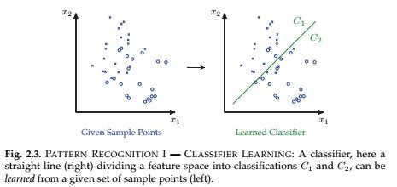
Classifier and Classification
18
Two Fundamental Steps Associated With Classification:
I. Classifier Learning and II. Classifier Testing or Validation

Slide 51
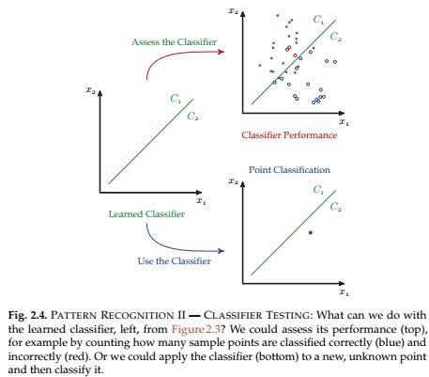
Classifier and Classification
19
II. Classifier Testing or Validation

Slide 52
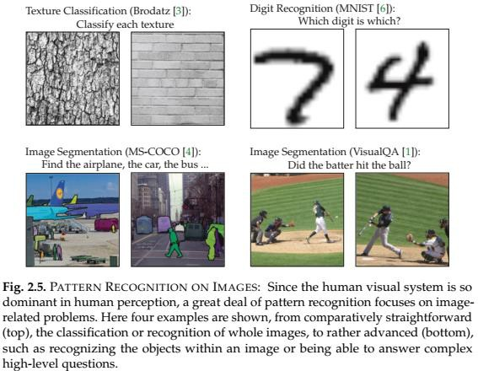
Classifier and Classification
20
Illustrative Examples of Classification

Slide 53
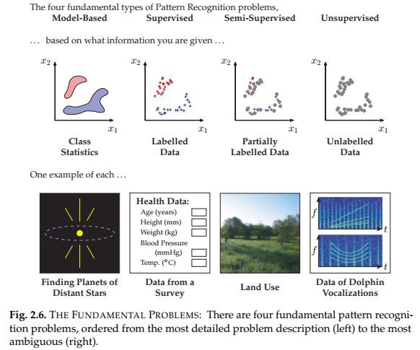
Classifier and Classification
21
Pattern Recognition Problems
Four Fundament Types PR Problems:
Model-Based
Supervised
Semi-Supervised
Unsupervised

Slide 54
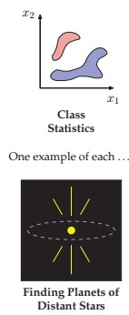
Classifier and Classification
22
Pattern Recognition Problem: Model-Based
Scenario 1 (Model-Based): Model is known or given
Hope to have most information regarding a PR problem the behaviour of the measurements for each of the pattern classes.
Normally characterized in a statistical fashion, such as p(y|C) = The distribution of measurement vector y given class C
Such detailed information will be available only in those contexts where the physical process is known by which a given pattern class gives rise to measurements.
Very convenient to have detailed information, since statistical decision theory allow to explicitly define the optimal classifier, in the sense of minimizing the probability of classification error

Slide 55
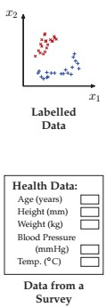
Classifier and Classification
23
Pattern Recognition Problem: Supervised
Scenario 2 (Supervised): Model is not known, labelled data are available
Do not have an exact description of the problem,
as in Scenario 1
Given labelled data, meaning data pairs of the form
{y_{i}; C_{κ}} -> The ith measurement vector y_{i} is in class C_{κ}
Labelled data do not just magically appear; labelled or tagged by a human observer, so refer scenario as supervised
Exceptionally expensive or labour-intensive with larger datasets.
May derive a classifier directly from the given labelled or learn an empirical probability model as of Scenario 1

Slide 56
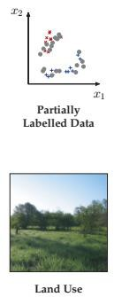
Classifier and Classification
24
Pattern Recognition Problem: Semi-Supervised
Scenario 3 (Semi-Supervised): Model is not known,
some are labelled data, some are not
Labelled data can be expensive, requiring manual labelling. A huge data be unlabeled and Scenario 2 ignores all unlabeled data.
Problem refers to as semi-supervised when some
degree of human input is required
In semi-supervised case, a small set of samples have been manually labelled for classification (e.g., face images tagged by a human observer), but then also to leverage a very large set of unlabeled data

Slide 57
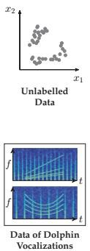
Classifier and Classification
25
Pattern Recognition Problem: Unsupervised
Scenario 4 (Unsupervised): Model is not known, no labelled data available
Pattern measurements are available, however the points have no associated class information; this is known as an unsupervised problem.
The range of problems here is still very broad, depending on whether we are told the number of classes, or their typical size or separation, or perhaps nothing at all.
Clustering problems are in Unsupervised category

Slide 58
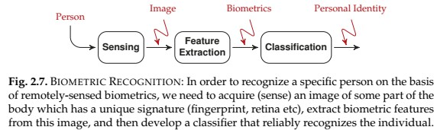
PR Case Study: Biometric Recognition
26
Biometrics
Basic Components of Biometric Recognition:
Face
Fingerprint
Iris (the colored region in your eye
around the pupil)
Retina (the pattern of arteries in the back of your eye)
Veins (vein structure in hand or arm)
DNA
Image Acquisition
Feature Extraction
Classification
The classifier returns one member of the class set
C = {NoMatch; Person₁; Person₂; : : : ; Person_{K}}
Classifying x as NoMatch where Person1 is correct: Frustration Classifying x as Person2 where Person1 is correct: Security Breach

Slide 59

PR Case Study: Biometric Recognition
27
Classifying x as NoMatch where Person1 is correct: Frustration Classifying x as Person2 where Person1 is correct: Security Breach
Avoiding frustration and security breaches, a successful biometric strategy must also satisfy
Universality: Every person should be measurable, regardless of age and health
Uniqueness: The feature vectors extracted for a given person
should be robustly unique
Consistency: For a given person the feature vector should be highly repeatable from one try to the next, and should be slowly (or not at all) varying over time.
Other criteria: non-invasiveness, social acceptability, or how easily the system would be to defeat via nefarious means and so on

Slide 60
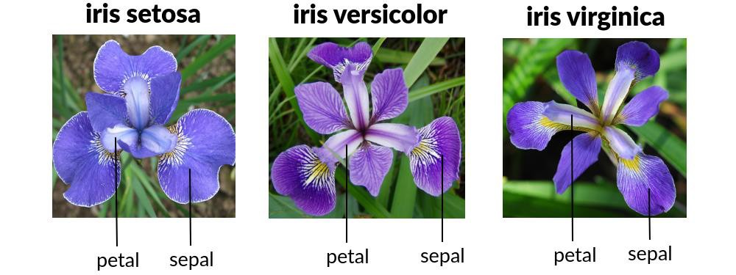
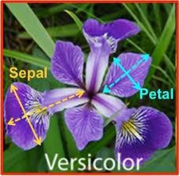
PR Hands-on: Iris Flower Recognition
28
C = {C₁; C₂; C₃} = {“Iris Setosa”, “Iris Versicolor”, “Iris Virginica”}
Each plant four measurements were taken:
Sepal Length Sepal Width Petal Length Petal Width
y =

Slide 61
Open Discussion
29

Slide 62
MCSE 666:Pattern and Speech Recognition
Learning
(Biological, Machine Learning, Regression, and Classification)
Dr. Md. Aminul Haque Akhand Dept. of CSE, SUB

Slide 63
Learning
2
Learning is the process of acquiring new or existing modifying
knowledge, behaviors, skills, values, or preferences
https://en.wikipedia.org/wiki/Learning
Learning is “a process that leads to change, which occurs as a result of experience and increases the potential for improved performance and future learning”
---(Ambrose et al, 2010, p.3).
“A change in human disposition or capability that persists over a period of time and is not simply ascribable to processes of growth.”
— From The Conditions of Learning by Robert Gagne

Slide 64
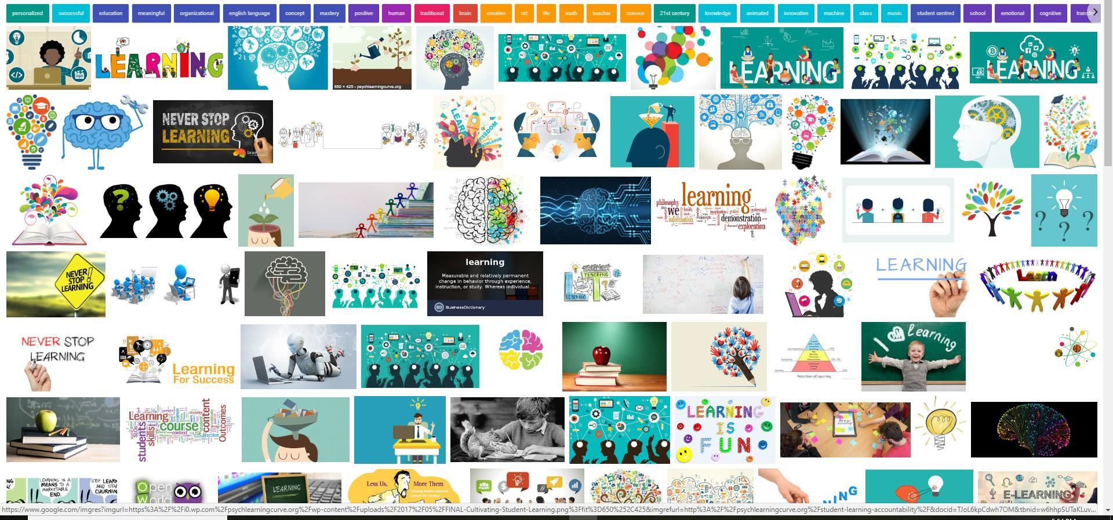
Learning
3
The change in the learner may happen at the level of knowledge, attitude, or behaviour. As a result of learning, learners come to see concepts, ideas, and/or the world differently.
Learning is not something done to students, but rather something students themselves do. It is the direct result of how students interpret and respond to their experiences. https://www.teachwithmrst.com/post/what-is-learning
Human brain is the main element of learning

Slide 65
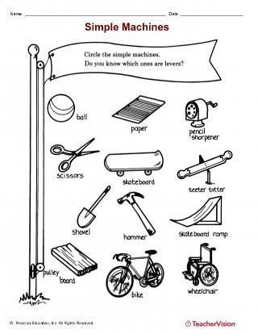
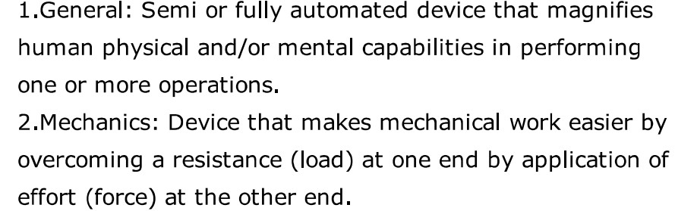
Machine
4
A machine is a physical system using power to apply forces and control movement to perform an action. … Machines can be driven by animals and people, by natural forces such as wind and water, and by chemical, thermal, or electrical power ...They can also include computers and sensors that monitor performance and plan movement, often called mechanical systems. https://en.wikipedia.org/wiki/Machine
An apparatus using or applying mechanical power and having several parts, each with a definite function and together performing a particular task. ‘a fax machine’
Oxford Dictionary

Slide 66
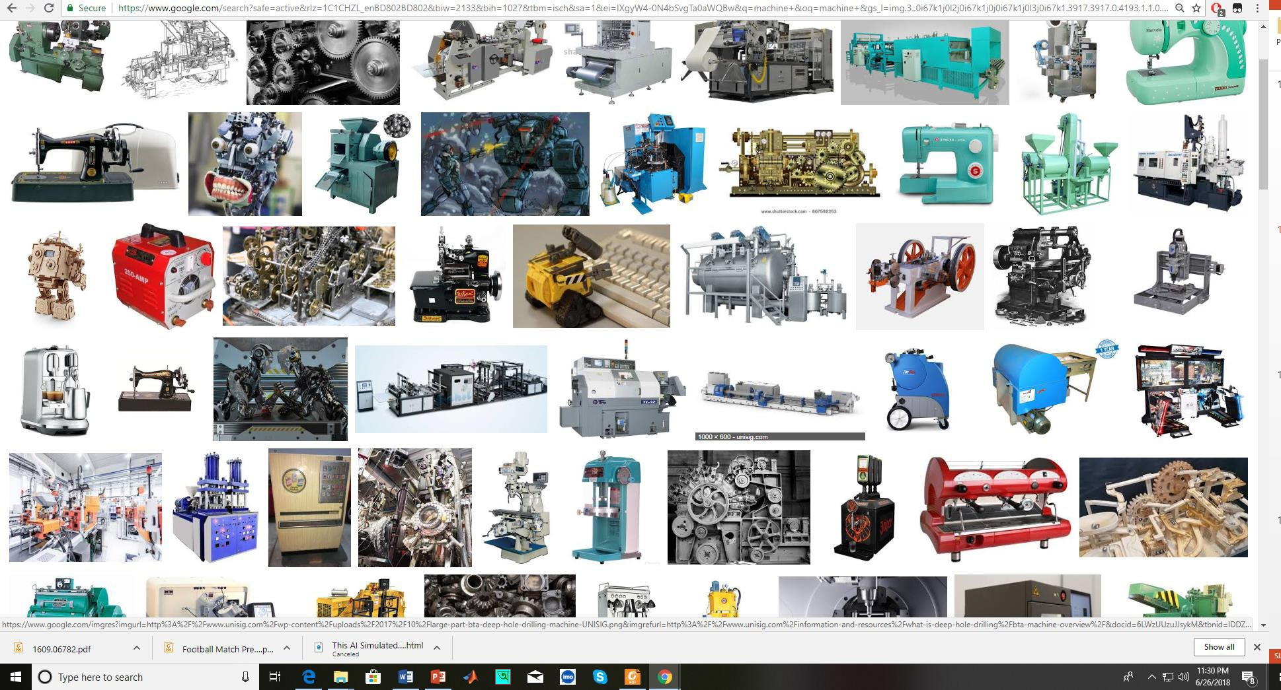
Machine
5
Machines include a system of mechanisms that shape the actuator input to achieve a specific application of output forces and movement.
How make decision to perform task(s)?

Slide 67
Machine Learning
6
In 1959, Arthur Samuel, a pioneer in the field of machine learning (ML) defined it as the “field of study that gives computers the ability to learn without being explicitly programmed”.
https://theconversation.com/what-is-machine-learning-76759
Machine learning (ML) is the study of computer algorithms that can improve automatically through experience and by the use of data.^{[1]} It is seen as a part of artificial intelligence. Machine learning algorithms build a model based on sample data, known as training data, in order to make predictions or decisions without being explicitly programmed to do so.^{[2]} Machine learning algorithms are used in a wide variety of applications, such as in medicine, email filtering, speech recognition, and computer vision, where it is difficult or unfeasible to develop conventional algorithms to perform the needed tasks.^{[3]}
https://en.wikipedia.org/wiki/Machine_learning

Slide 68
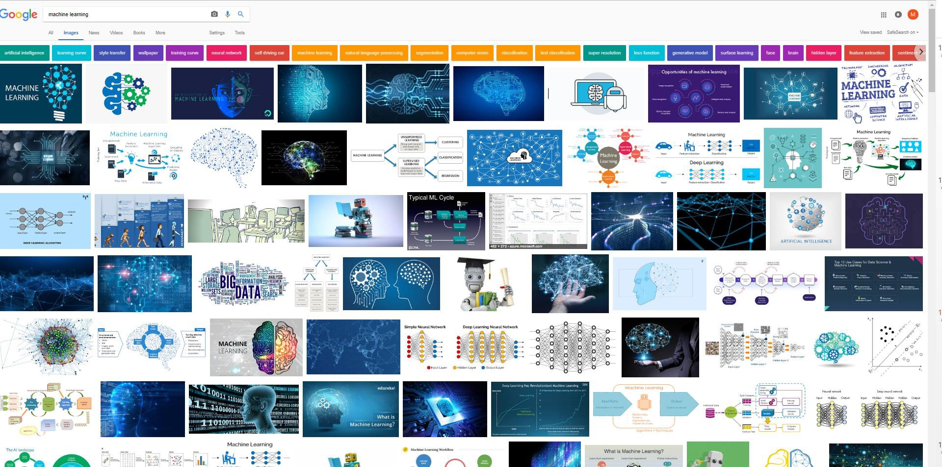
Machine Learning
7
Technique to give computer brain like learning ability through progressively update with data,
without being explicitly programmed.

Slide 69
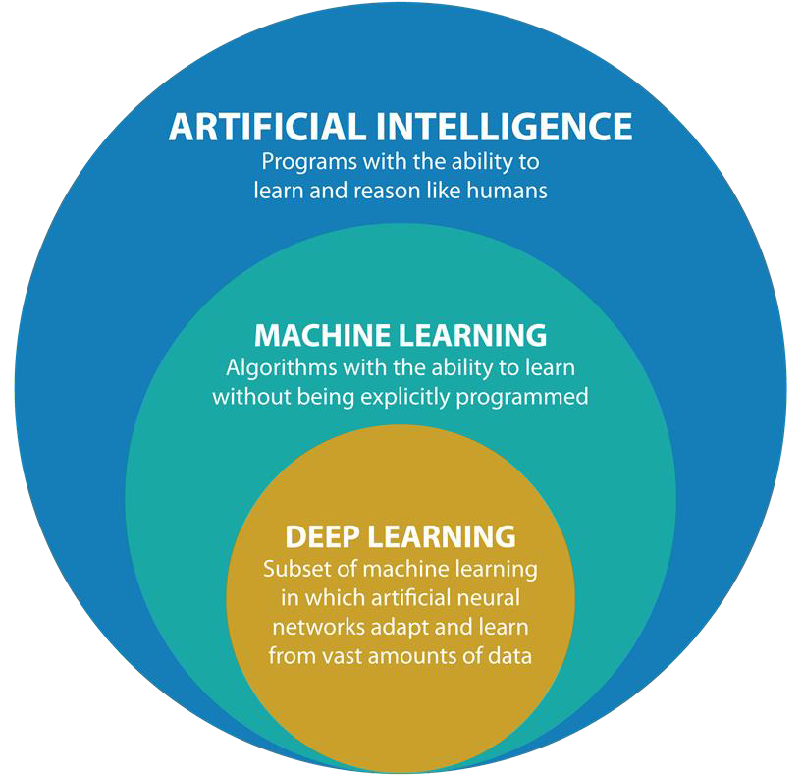
AI ->Machine Learning->Deep Learning
8
https://www.argility.com/argility-ecosystem-solutions/industry-4-0/machine-learning-deep-learning/

Slide 70
AI ->Machine Learning->Deep Learning
9
Artificial Intelligence (AI)
AI is the broadest term, applying to any technique that enables computers to mimic human intelligence, using logic, if-then rules, decision trees, and machine learning (including deep learning).
Machine Learning
The subset of AI that includes that enable machines to improve at tasks with experience. The category includes deep learning.
Deep Learning
The subset of machine learning composed of algorithms to train itself to perform tasks, like speech and image recognition, by exposing multilayered neural networks to vast amounts of data.

Slide 71
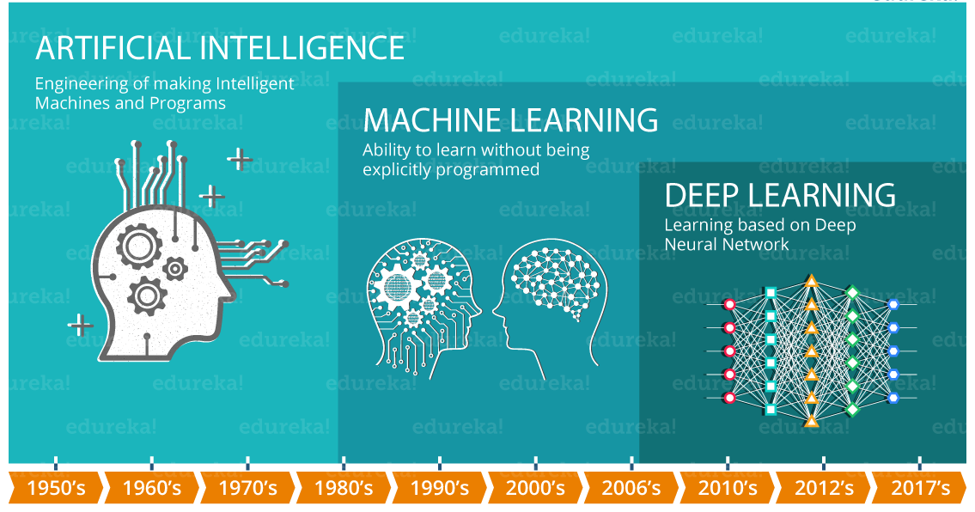
AI ->Machine Learning->Deep Learning
11

Slide 72
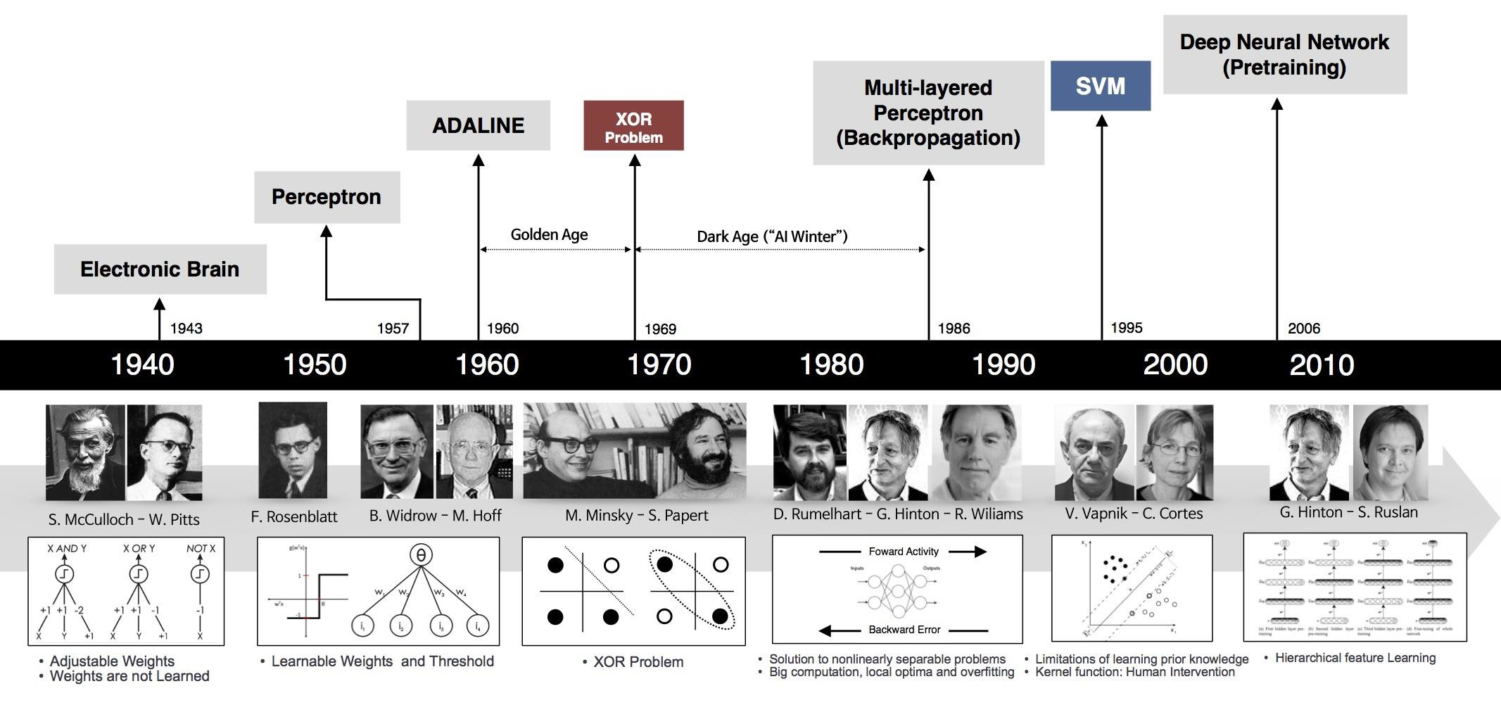
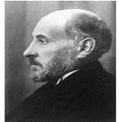
History of ML and Deep Learning
12
1906
Neuron/ Nerve Cell
Ramon y Cajal
Artificial Neuron
Solving Real-Life Problem with Extracted Features
Development of Traditional Machine Learning
Deep Leaning
https://beamandrew.github.io/deeplearning/2017/02/23/deep_learning_101_part1.html

Slide 73
Learning Related to Pattern Recognition

Slide 74
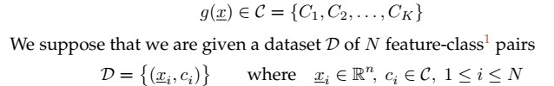
Learning in Pattern Recognition
14
What Does It Mean to Learn?
What does it mean to have learned?
How do we recognize that an algorithm or a method, regardless of
how simple or complex, has succeeded in learning?
The object being learned is a classifier g(x), some sort of black-box / function
/ algorithm / method / concept / system which takes a given feature x and returns the associated class C:

Slide 75
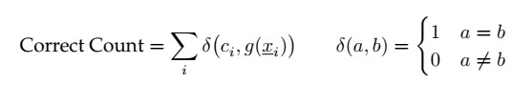
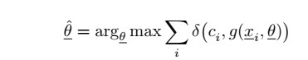
Learning in Pattern Recognition
15
The most primitive type of learning is just memorization, in which case we would consider g() to have learned from the given dataset based on the number of feature- class pairs it successfully reproduces:
In principle, memorization is actually a credible approach to developing a
classifier, however in general there are two significant limitations:
Memorizing is hard : memory concern
Memorizing is not enough: learning is not just to remember
#Generalize is more important
conclusions about
to learning, to
which
be able to reach correct
not seen.
instances
you have

Slide 76
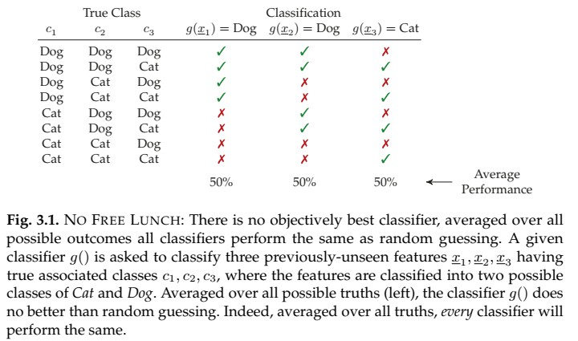
Learning in Pattern Recognition
1
6
Averaged over all possibilities for the unseen data, no classifier generalizes better than any other!

Slide 77
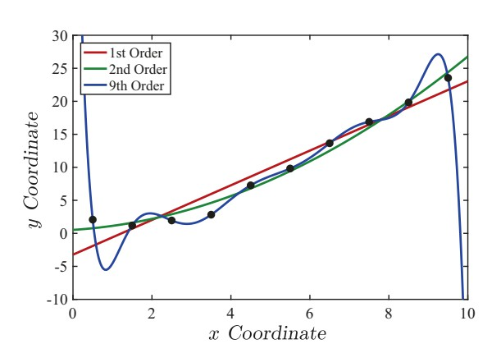
Robustness in Learning
17
Fig. 3.2. What does it mean to fit a model to data? Here we have ten data points
model
(black
dots),
which
come
from
some
unknown
with
added
random noise. We
fit polynomials
to the
points,
for which the
first-order
(linear
regression),
second-order
(parabolic always be polynomial of the data.
regression),
found that
and
ninth-order
fits
p + 1 given
it seems
are shown.
A pth-order polynomial
can
passes
through
points,
so here the ninth-order
fits the points exactly, however
like a very unlikely generalization

Slide 78
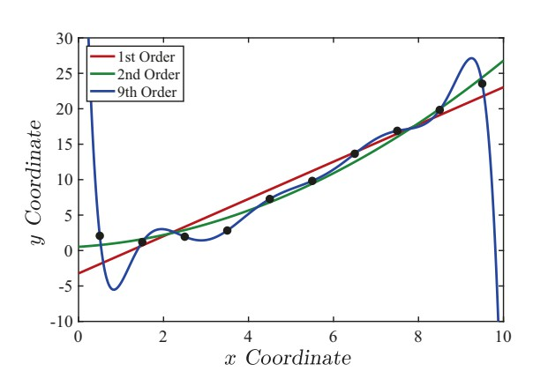
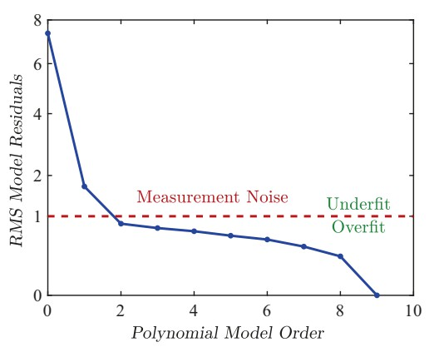

Robustness in Learning
18
Fig. 3.3. Following up on Figure 3.2, we can plot the root-mean-square (RMS) difference between the polynomial fit and the data points, as a function of the polynomial order. In this case the measurement noise level was assumed to have been provided, it was not learned.
In this example the added noise has a standard deviation of σ = 1, meaning that for the correct model, RMS(θexact) = 1. As a result,
Any RMS difference below σ must be overfitting, meaning that g(x; θ) is partly fitting to noise, by taking some of the noise into account when learning θ;
Any RMS difference above σ suggests that the learned model has not adequately generalized, or has not been given adequate flexibility in θ (enough degrees of freedom q) to capture the variations that need to be captured.

Slide 79

Robustness in Learning
19
Fig. 3.4. Overfitting: Any learning, whether of linear regression (here) or a pattern recognition classifier (Figure 3.5), is said to be overfitting if it begins to tune its parameters to the behaviour of the noise, rather than of the underlying phenomenon we wish to learn. The estimated line (red) is quite plausible, given the four data points (red dots), however it is clear how the line has accommodated (fit) the noise, to make the residuals (green) smaller

Slide 80


Robustness in Learning
20

Slide 81

Robustness in Learning
21
Fig. 3.5. OVERFITTING: As in Figure 3.4, but here for a pattern recognition classifier. We will have to wait for Chapter 6 for the details of the classifier to be discussed, however the principle is the same as in regression: Any learning is overfitting if it tunes its parameters to the behaviour of the noise. That tuning is obvious here, in that the memorized classifier (right) is tuning its decision (coloured background) on the basis of individual training points, significantly distracted from the correct or ideal classification (left).

Slide 82






Regression and Classification
22

Slide 83






Regression and Classification
23

Slide 84




24
Regression and Classification
Fig. 3.7. We have separate training and testing data (left), such that the learned model (red line) is deduced from the training data, but assessed against the testing data. Observe the degree to which the estimated line fits to the noise, based on the difference between the fit to training data (overfit, under-reporting model inconsistency) and the fit to testing data (which is an accurate, objective assessment).

Slide 85





Use of Data in Learning
25

Slide 86

Classifier Evaluation / Performance Measure
26
Test Set Accuracy
Test Set Error Rate
Confusion Matrix

Slide 87

Classifier Validation
27

Slide 88


K-nearest neighbors (KNN) Classifier
28
Lazy learning algorithm − KNN is a lazy learning algorithm because it does not have a specialized training phase and uses all the data for training while classification.
Non-parametric learning algorithm − KNN is also a non-parametric learning algorithm because it doesn’t assume anything about the underlying data.
https://www.tutorialspoint.com/machine_learning_with_python/machine_learning_with_pyt hon_knn_algorithm_finding_nearest_neighbors.htm

Slide 89
29
K-nearest neighbors (KNN) Classifier
- The Simplest Classifier

Slide 90


K-nearest neighbors (KNN) Classifier
30
The boundary becomes smoother with increasing value of K.
With K increasing to infinity it finally becomes all blue or all red depending on the total majority.
https://www.analyticsvidhya.com/blog/2018/03/introduction-k-neighbours-algorithm- clustering/#h-what-is-knn-k-nearest-neighbor-algorithm

Slide 91
K-nearest neighbors (KNN) Classifier
31
Pros of KNN
Very simple algorithm to understand and interpret.
Very useful for nonlinear data because there is no assumption about data in this
algorithm.
Versatile algorithm as we can use it for classification as well as regression.
High accuracy but there are much better supervised learning models than KNN.
Cons of KNN
Computationally a bit expensive algorithm because it stores all the training data.
High memory storage required as compared to other supervised algorithms.
Prediction is slow in case of big N.
Very sensitive to the scale of data as well as irrelevant features.
learning
Applications of KNN
Banking System: to predict weather an individual is fit for loan approval? Does that individual have the characteristics similar to the defaulters one?
Calculating Credit Ratings: can be used to find an individual’s credit rating by comparing with the persons having similar traits.
Other areas in which KNN algorithm can be used are Speech Recognition, Handwriting
Detection, Image Recognition and Video Recognition.

Slide 92
Thanks for your attention
32
Question and Answer

Slide 93
MCSE 666:
Pattern and Speech Recognition
Aspect & Prospect
Dr. Md. Aminul Haque Akhand Dept. of CSE, SUB

Slide 94
PG Course: Instructor vs. Student Qualification and Contribution
2
PhD
MSc
UG
Instructor
Instructor
HSC
SSC
PSC
PSC SSC HSC
UG MSc
Student
Student
Qualification
Contribution

Slide 95
Pattern and Speech Recognition (PSR)
3
Pattern
Speech Recognition

Slide 96
PSR Individual Terms: Pattern
4

Slide 97
PSR Individual Terms: Pattern
5
A pattern is a regularity in the world, in human-made design, or in abstract ideas. The elements of a pattern repeat in a predictable manner. A geometric pattern is a kind of pattern formed of geometric shapes and typically repeated like a wallpaper design.

Slide 98
PSR Individual Terms: Speech
6

Slide 99
PSR Individual Terms: Speech
7
Speech, language refer to the means of communication used by people. Speech is the expression of ideas and thoughts by means of articulate vocal sounds, or the faculty of thus expressing ideas and thoughts.

Slide 100
PSR Individual Terms: Recognition
8

Slide 101
PSR Individual Terms: Recognition
9
Recognition in sociology is the public acknowledgment of a person's status or merits (achievements, virtues, service, etc.).
Another example of recognition is when some person is accorded some special status, such as title or classification.

Slide 102
Pattern and Speech Recognition (PSR)
10
Pattern Speech Recognition
Speech Pattern Recognition
Pattern Recognition and
Speech Recognition
Intelligent Pattern Recognition and
Intelligent Speech Recognition

Slide 103
Examples of Pattern Recognition
11
Mayank Parasher et al., Anatomy on Pattern Recognition, June 2011, Indian Journal of Computer Science and Engineering 2(3)

Slide 104
Examples of Pattern Recognition
12
What Are the Real-World Applications of Pattern Recognition?
https://serokell.io/blog/applications-of-pattern-recognition
10 Real Life Examples Of Pattern Recognition
https://numberdyslexia.com/pattern-recognition-real-life-examples/
Pattern recognition and use in real life problem solving
https://suresolv.com/problem-solving-techniques/pattern-recognition-and-use- real-life-problem-solving
What is pattern recognition and why it matters? Definitive guide
https://theappsolutions.com/blog/development/pattern-recognition-guide/

Slide 105
MCSE 666: Pattern and Speech Recognition
13
SUB MCSE 666 Syllabus or Course Outline
Introduction to formal languages and patterns; string languages for pattern description; higher dimensional pattern grammars; syntax analysis as a recognition procedure; stochastic languages; error correcting parsing for string languages; error-correcting tree automata; cluster analysis for syntactic patterns; grammatical inference for syntactic pattern recognition; syntactic approach to texture analysis;
Speech signal: production, perception and characterization; signal analysis; pattern comparison techniques: distortion
processing and
measures, spectral-distortion measures, time alignment and normalization; recognition system design and implementation: source-coding, template training, and performance analysis; connected word models; continuous speech recognition: sub word units, statistical modeling, and context- dependent units; task oriented models.

Slide 106
Textbooks
14

Slide 107
Open Discussion on Course Conduction
15

Slide 108
Introduction to Pattern Recognition
MCSE 666:Pattern and Speech Recognition
Dr. Md. Aminul Haque Akhand Dept. of CSE, SUB

Slide 109
What Is Pattern Recognition?
2
Pattern recognition (PR) is a process by which some input is measured, analyzed, and then classified as belonging to one of a set of classes
Process of PR and classification is a continual, never ending
aspect of every-day human existence:

Slide 110
What Is Pattern Recognition? Cont.
3
PR as a human experience refers to a perceptual process: some form of sensory input is sensed, analyzed, and recognized (classified), either subconsciously (by instinct) or consciously (based on previous experience).
Patterns may be presented in any sensory modality: vision, hearing, touch, taste, or smell.
PR as a technical discipline: a process in which an input object is measured, analyzed, and classified by a machine as being more or less similar to some class in a set of classes.

Slide 111
Pattern Recognition Framework
4
The goal of PR is to provide a machine with a kind of perceptual capability to automatically extract useful information from measured data.

Slide 112
5
PR Illustration with Example
Pattern Recognition of Text

Slide 113
PR Illustration with Example
6
Pattern Recognition of the Mind
It deons’t mettar in waht oerdr the lrttees in a wrod are, as lnog as the frist and lsat ltteres rmeain in the rgiht pacle.
The retina in the eye is densely packed with light-sensitive cells, so that it may be tempting to think
Our brain effectively sees and perceives the world as a great many pixels.
There are many simple mind tricks or optical illusions

Slide 114
PR Illustration with Example
7
Pattern Recognition of the Mind
The eye is not just sending pixellated images to the brain.
There is a great deal of feature extraction taking place, much already in the retina
It is very helpful in running through a forest, but perhaps not so useful in staring at deliberately manipulated images on a page.

Slide 115
Features from Patterns
8
The word “pattern” may bring to mind texture, fabric, or shape.
In the context of pattern recognition, the notion of pattern is far more broad, and can apply to any thing that can be distinguished from another thing.
Identity view point: infer the unknown identity of an object
Type of wildflower, type of songbird, or the name of the person facing a camera — each of these has a certain identity to determine from measurements.
A pattern is assumed to have certain properties or
attributes which distinguishes it from other patterns.

Slide 116
Features from Patterns (Cont.)
9
One or more measurements are taken of a pattern
Size / weight of a piece
Various dimensions from face
Does all measurements from patterns important to distinguish?

Slide 117
Features from Patterns (Cont.)
10
The selection of appropriate measurements is an essential
Measurements may cost money and/or time, and
Poor measurements lead to poor performance of the resulting classifier.
The process of transforming measurements into features facilitate classification, normally in one or both of the following ways:
By reducing the dimensionality of the problem: n < m
By creating
features in which patterns are more clearly
distinguished.

Slide 118
Features from Patterns (Cont.)
11
The feature extraction function f() can focus the information from x, or it can remove irrelevant information from x, but f() never adds information.
Data Processing Theorem: x can never have more
information than was present in y.
An effective feature extraction function f() can make the PR problem easier,
However, in principle, the best possible classifier based on the measurements y should perform at least as well as the best possible classifier based on the features x.

Slide 119
Features from Patterns (Cont.)
12
Features may be intuitive or they may be quite abstract.
Consider, the measurements of an electric motor:
Power as Feature: Understandable
Uninterpretable feature do not
make any physical sense,
But perhaps be effective as a feature for classification.

Slide 120
Classes and Classification
13
The whole purpose of PR or classification consists of
assigning an object to a class.
A class is a particular pattern, or possibly a group of patterns which are similar or equivalent in some sense.
In a given problem, the set of classes C is defined as
C = {C₁; C₂; -; -; -; -; C_{K} };
Have to choose one class from K different classes.
Members of a class share some common properties or attributes
In PR problems the class set C is predefined and has been specified as part of the problem to be solved.

Slide 121
Classes and Classification
14

Slide 122
Classes and Classification
15
Way of Describing Classes
Via Prototype Idealized representation or notion of the “essence” of the class. Pros: each class is unambiguously defined, Cons: no scope for variability.
Via Parameterized Shape: A generalization of the prototype; the class has a known shape (e.g., rectangular or elliptical), the shape is described in some number of parameters (e.g., ellipse centre, rotation, and axis lengths). Pros. more flexible than that of a single prototype, Cons: still requires the type of shape to be assumed or known.
Via Statistical Distribution: Some description of the likelihood or probability of a class member having a particular set of measurements or features. Pros.: very comprehensive, Cons: There will be circumstances when the statistics are not known and may be difficult to infer.
Via Samples: A set of given samples (many apples, or tigers, or bicycles) directly characterizes the class. Pros: Highly convenient, since nothing further needs to be done to describe the class Cons: Storage and computational challenges, since all of the data need to be saved.

Slide 123
Classes and Classification
16
Variability in a Class
Patterns do not need to be identical to belong to the same class: not all pictures of a person the same, or of tigers, or of apples.
There are at least two sources of variability present in the measurements associated with a single class:
The inherent variability within a class: Every class will consist of members which differ in some way. The degree and nature of the inherent variability will depend greatly on the class definition.
“Fruit” class contains all manners of variability in colour, size, and shape; “Apple” class is much more specific, but apples do come in different colours and patterning; the “Granny Smith Apple” class is even more specific, but still will have apples of different sizes or with more or fewer blemishes.
Noise or random variations in measurement: Every measurement
involves some sort of physical process which will be subject to error, such as thermal noise in electronics, or quantization noise in converting an analogue signal to a digital representation.

Slide 124
Open Discussion on Course Conduction
17

Slide 125
Introduction to Pattern Recognition
MCSE 666:Pattern and Speech Recognition
Dr. Md. Aminul Haque Akhand Dept. of CSE, SUB

Slide 126
What Is Pattern Recognition?
2
Pattern recognition (PR) is a process by which some input is measured, analyzed, and then classified as belonging to one of a set of classes
Process of PR and classification is a continual, never ending
aspect of every-day human existence:

Slide 127
What Is Pattern Recognition? Cont.
3
PR as a human experience refers to a perceptual process: some form of sensory input is sensed, analyzed, and recognized (classified), either subconsciously (by instinct) or consciously (based on previous experience).
Patterns may be presented in any sensory modality: vision, hearing, touch, taste, or smell.
PR as a technical discipline: a process in which an input object is measured, analyzed, and classified by a machine as being more or less similar to some class in a set of classes.

Slide 128
Pattern Recognition Framework
4
The goal of PR is to provide a machine with a kind of perceptual capability to automatically extract useful information from measured data.

Slide 129
5
PR Illustration with Example
Pattern Recognition of Text

Slide 130
PR Illustration with Example
6
Pattern Recognition of the Mind
It deons’t mettar in waht oerdr the lrttees in a wrod are, as lnog as the frist and lsat ltteres rmeain in the rgiht pacle.
The retina in the eye is densely packed with light-sensitive cells, so that it may be tempting to think
Our brain effectively sees and perceives the world as a great many pixels.
There are many simple mind tricks or optical illusions

Slide 131
PR Illustration with Example
7
Pattern Recognition of the Mind
The eye is not just sending pixellated images to the brain.
There is a great deal of feature extraction taking place, much already in the retina
It is very helpful in running through a forest, but perhaps not so useful in staring at deliberately manipulated images on a page.

Slide 132
Features from Patterns
8
The word “pattern” may bring to mind texture, fabric, or shape.
In the context of pattern recognition, the notion of pattern is far more broad, and can apply to any thing that can be distinguished from another thing.
Identity view point: infer the unknown identity of an object
Type of wildflower, type of songbird, or the name of the person facing a camera — each of these has a certain identity to determine from measurements.
A pattern is assumed to have certain properties or
attributes which distinguishes it from other patterns.

Slide 133
Features from Patterns (Cont.)
9
One or more measurements are taken of a pattern
Size / weight of a piece
Various dimensions from face
Does all measurements from patterns important to distinguish?

Slide 134
Features from Patterns (Cont.)
10
The selection of appropriate measurements is an essential
Measurements may cost money and/or time, and
Poor measurements lead to poor performance of the resulting classifier.
The process of transforming measurements into features facilitate classification, normally in one or both of the following ways:
By reducing the dimensionality of the problem: n < m
By creating
features in which patterns are more clearly
distinguished.

Slide 135
Features from Patterns (Cont.)
11
The feature extraction function f() can focus the information from x, or it can remove irrelevant information from x, but f() never adds information.
Data Processing Theorem: x can never have more
information than was present in y.
An effective feature extraction function f() can make the PR problem easier,
However, in principle, the best possible classifier based on the measurements y should perform at least as well as the best possible classifier based on the features x.

Slide 136
Features from Patterns (Cont.)
12
Features may be intuitive or they may be quite abstract.
Consider, the measurements of an electric motor:
Power as Feature: Understandable
Uninterpretable feature do not
make any physical sense,
But perhaps be effective as a feature for classification.

Slide 137
Classes and Classification
13
The whole purpose of PR or classification consists of
assigning an object to a class.
A class is a particular pattern, or possibly a group of patterns which are similar or equivalent in some sense.
In a given problem, the set of classes C is defined as
C = {C₁; C₂; -; -; -; -; C_{K} };
Have to choose one class from K different classes.
Members of a class share some common properties or attributes
In PR problems the class set C is predefined and has been specified as part of the problem to be solved.

Slide 138
Classes and Classification
14

Slide 139
Classes and Classification
15
Way of Describing Classes
Via Prototype Idealized representation or notion of the “essence” of the class. Pros: each class is unambiguously defined, Cons: no scope for variability.
Via Parameterized Shape: A generalization of the prototype; the class has a known shape (e.g., rectangular or elliptical), the shape is described in some number of parameters (e.g., ellipse centre, rotation, and axis lengths). Pros. more flexible than that of a single prototype, Cons: still requires the type of shape to be assumed or known.
Via Statistical Distribution: Some description of the likelihood or probability of a class member having a particular set of measurements or features. Pros.: very comprehensive, Cons: There will be circumstances when the statistics are not known and may be difficult to infer.
Via Samples: A set of given samples (many apples, or tigers, or bicycles) directly characterizes the class. Pros: Highly convenient, since nothing further needs to be done to describe the class Cons: Storage and computational challenges, since all of the data need to be saved.

Slide 140
Classes and Classification
16
Variability in a Class
Patterns do not need to be identical to belong to the same class: not all pictures of a person the same, or of tigers, or of apples.
There are at least two sources of variability present in the measurements associated with a single class:
The inherent variability within a class: Every class will consist of members which differ in some way. The degree and nature of the inherent variability will depend greatly on the class definition.
“Fruit” class contains all manners of variability in colour, size, and shape; “Apple” class is much more specific, but apples do come in different colours and patterning; the “Granny Smith Apple” class is even more specific, but still will have apples of different sizes or with more or fewer blemishes.
Noise or random variations in measurement: Every measurement
involves some sort of physical process which will be subject to error, such as thermal noise in electronics, or quantization noise in converting an analogue signal to a digital representation.

Slide 141
Classifier and Classification
17
In PR tasks the class set C is predefined and has been specified as part of the problem to be solved.
A classifier is some function g(), possibly analytical (i.e., an equation) or a computer algorithm, which assigns a class label to a given feature:
g(x) ∈ C = {C₁; C₂; : : : ; C_{K}}
There is a strong relationship between feature extraction and classification, such that
Good features allow for simpler classifiers, whereas
Complex classifiers can compensate for weaker features, which are unable to fully separate the pattern classes.

Slide 142
Classifier and Classification
18
Two Fundamental Steps Associated With Classification:
I. Classifier Learning and II. Classifier Testing or Validation

Slide 143
Classifier and Classification
19
II. Classifier Testing or Validation

Slide 144
Classifier and Classification
20
Illustrative Examples of Classification

Slide 145
Classifier and Classification
21
Pattern Recognition Problems
Four Fundament Types PR Problems:
Model-Based
Supervised
Semi-Supervised
Unsupervised

Slide 146
Classifier and Classification
22
Pattern Recognition Problem: Model-Based
Scenario 1 (Model-Based): Model is known or given
Hope to have most information regarding a PR problem the behaviour of the measurements for each of the pattern classes.
Normally characterized in a statistical fashion, such as p(y|C) = The distribution of measurement vector y given class C
Such detailed information will be available only in those contexts where the physical process is known by which a given pattern class gives rise to measurements.
Very convenient to have detailed information, since statistical decision theory allow to explicitly define the optimal classifier, in the sense of minimizing the probability of classification error

Slide 147
Classifier and Classification
23
Pattern Recognition Problem: Supervised
Scenario 2 (Supervised): Model is not known, labelled data are available
Do not have an exact description of the problem,
as in Scenario 1
Given labelled data, meaning data pairs of the form
{y_{i}; C_{κ}} -> The ith measurement vector y_{i} is in class C_{κ}
Labelled data do not just magically appear; labelled or tagged by a human observer, so refer scenario as supervised
Exceptionally expensive or labour-intensive with larger datasets.
May derive a classifier directly from the given labelled or learn an empirical probability model as of Scenario 1

Slide 148
Classifier and Classification
24
Pattern Recognition Problem: Semi-Supervised
Scenario 3 (Semi-Supervised): Model is not known,
some are labelled data, some are not
Labelled data can be expensive, requiring manual labelling. A huge data be unlabeled and Scenario 2 ignores all unlabeled data.
Problem refers to as semi-supervised when some
degree of human input is required
In semi-supervised case, a small set of samples have been manually labelled for classification (e.g., face images tagged by a human observer), but then also to leverage a very large set of unlabeled data

Slide 149
Classifier and Classification
25
Pattern Recognition Problem: Unsupervised
Scenario 4 (Unsupervised): Model is not known, no labelled data available
Pattern measurements are available, however the points have no associated class information; this is known as an unsupervised problem.
The range of problems here is still very broad, depending on whether we are told the number of classes, or their typical size or separation, or perhaps nothing at all.
Clustering problems are in Unsupervised category

Slide 150
PR Case Study: Biometric Recognition
26
Biometrics
Basic Components of Biometric Recognition:
Face
Fingerprint
Iris (the colored region in your eye
around the pupil)
Retina (the pattern of arteries in the back of your eye)
Veins (vein structure in hand or arm)
DNA
Image Acquisition
Feature Extraction
Classification
The classifier returns one member of the class set
C = {NoMatch; Person₁; Person₂; : : : ; Person_{K}}
Classifying x as NoMatch where Person1 is correct: Frustration Classifying x as Person2 where Person1 is correct: Security Breach

Slide 151
PR Case Study: Biometric Recognition
27
Classifying x as NoMatch where Person1 is correct: Frustration Classifying x as Person2 where Person1 is correct: Security Breach
Avoiding frustration and security breaches, a successful biometric strategy must also satisfy
Universality: Every person should be measurable, regardless of age and health
Uniqueness: The feature vectors extracted for a given person
should be robustly unique
Consistency: For a given person the feature vector should be highly repeatable from one try to the next, and should be slowly (or not at all) varying over time.
Other criteria: non-invasiveness, social acceptability, or how easily the system would be to defeat via nefarious means and so on

Slide 152
PR Hands-on: Iris Flower Recognition
28
C = {C₁; C₂; C₃} = {“Iris Setosa”, “Iris Versicolor”, “Iris Virginica”}
Each plant four measurements were taken:
Sepal Length Sepal Width Petal Length Petal Width
y =

Slide 153
Open Discussion
29

Slide 154
MCSE 666:Pattern and Speech Recognition
Learning
(Biological, Machine Learning, Regression, and Classification)
Dr. Md. Aminul Haque Akhand Dept. of CSE, SUB

Slide 155
Learning
2
Learning is the process of acquiring new or existing modifying
knowledge, behaviors, skills, values, or preferences
https://en.wikipedia.org/wiki/Learning
Learning is “a process that leads to change, which occurs as a result of experience and increases the potential for improved performance and future learning”
---(Ambrose et al, 2010, p.3).
“A change in human disposition or capability that persists over a period of time and is not simply ascribable to processes of growth.”
— From The Conditions of Learning by Robert Gagne

Slide 156
Learning
3
The change in the learner may happen at the level of knowledge, attitude, or behaviour. As a result of learning, learners come to see concepts, ideas, and/or the world differently.
Learning is not something done to students, but rather something students themselves do. It is the direct result of how students interpret and respond to their experiences. https://www.teachwithmrst.com/post/what-is-learning
Human brain is the main element of learning

Slide 157
Machine
4
A machine is a physical system using power to apply forces and control movement to perform an action. … Machines can be driven by animals and people, by natural forces such as wind and water, and by chemical, thermal, or electrical power ...They can also include computers and sensors that monitor performance and plan movement, often called mechanical systems. https://en.wikipedia.org/wiki/Machine
An apparatus using or applying mechanical power and having several parts, each with a definite function and together performing a particular task. ‘a fax machine’
Oxford Dictionary

Slide 158
Machine
5
Machines include a system of mechanisms that shape the actuator input to achieve a specific application of output forces and movement.
How make decision to perform task(s)?

Slide 159
Machine Learning
6
In 1959, Arthur Samuel, a pioneer in the field of machine learning (ML) defined it as the “field of study that gives computers the ability to learn without being explicitly programmed”.
https://theconversation.com/what-is-machine-learning-76759
Machine learning (ML) is the study of computer algorithms that can improve automatically through experience and by the use of data.^{[1]} It is seen as a part of artificial intelligence. Machine learning algorithms build a model based on sample data, known as training data, in order to make predictions or decisions without being explicitly programmed to do so.^{[2]} Machine learning algorithms are used in a wide variety of applications, such as in medicine, email filtering, speech recognition, and computer vision, where it is difficult or unfeasible to develop conventional algorithms to perform the needed tasks.^{[3]}
https://en.wikipedia.org/wiki/Machine_learning

Slide 160
Machine Learning
7
Technique to give computer brain like learning ability through progressively update with data,
without being explicitly programmed.

Slide 161
AI ->Machine Learning->Deep Learning
8
https://www.argility.com/argility-ecosystem-solutions/industry-4-0/machine-learning-deep-learning/

Slide 162
AI ->Machine Learning->Deep Learning
9
Artificial Intelligence (AI)
AI is the broadest term, applying to any technique that enables computers to mimic human intelligence, using logic, if-then rules, decision trees, and machine learning (including deep learning).
Machine Learning
The subset of AI that includes that enable machines to improve at tasks with experience. The category includes deep learning.
Deep Learning
The subset of machine learning composed of algorithms to train itself to perform tasks, like speech and image recognition, by exposing multilayered neural networks to vast amounts of data.

Slide 163
AI ->Machine Learning->Deep Learning
11

Slide 164
History of ML and Deep Learning
12
1906
Neuron/ Nerve Cell
Ramon y Cajal
Artificial Neuron
Solving Real-Life Problem with Extracted Features
Development of Traditional Machine Learning
Deep Leaning
https://beamandrew.github.io/deeplearning/2017/02/23/deep_learning_101_part1.html

Slide 165
Learning Related to Pattern Recognition

Slide 166
Learning in Pattern Recognition
14
What Does It Mean to Learn?
What does it mean to have learned?
How do we recognize that an algorithm or a method, regardless of
how simple or complex, has succeeded in learning?
The object being learned is a classifier g(x), some sort of black-box / function
/ algorithm / method / concept / system which takes a given feature x and returns the associated class C:

Slide 167
Learning in Pattern Recognition
15
The most primitive type of learning is just memorization, in which case we would consider g() to have learned from the given dataset based on the number of feature- class pairs it successfully reproduces:
In principle, memorization is actually a credible approach to developing a
classifier, however in general there are two significant limitations:
Memorizing is hard : memory concern
Memorizing is not enough: learning is not just to remember
#Generalize is more important
conclusions about
to learning, to
which
be able to reach correct
not seen.
instances
you have

Slide 168
Learning in Pattern Recognition
1
6
Averaged over all possibilities for the unseen data, no classifier generalizes better than any other!

Slide 169
Robustness in Learning
17
Fig. 3.2. What does it mean to fit a model to data? Here we have ten data points
model
(black
dots),
which
come
from
some
unknown
with
added
random noise. We
fit polynomials
to the
points,
for which the
first-order
(linear
regression),
second-order
(parabolic always be polynomial of the data.
regression),
found that
and
ninth-order
fits
p + 1 given
it seems
are shown.
A pth-order polynomial
can
passes
through
points,
so here the ninth-order
fits the points exactly, however
like a very unlikely generalization

Slide 170
Robustness in Learning
18
Fig. 3.3. Following up on Figure 3.2, we can plot the root-mean-square (RMS) difference between the polynomial fit and the data points, as a function of the polynomial order. In this case the measurement noise level was assumed to have been provided, it was not learned.
In this example the added noise has a standard deviation of σ = 1, meaning that for the correct model, RMS(θexact) = 1. As a result,
Any RMS difference below σ must be overfitting, meaning that g(x; θ) is partly fitting to noise, by taking some of the noise into account when learning θ;
Any RMS difference above σ suggests that the learned model has not adequately generalized, or has not been given adequate flexibility in θ (enough degrees of freedom q) to capture the variations that need to be captured.

Slide 171
Robustness in Learning
19
Fig. 3.4. Overfitting: Any learning, whether of linear regression (here) or a pattern recognition classifier (Figure 3.5), is said to be overfitting if it begins to tune its parameters to the behaviour of the noise, rather than of the underlying phenomenon we wish to learn. The estimated line (red) is quite plausible, given the four data points (red dots), however it is clear how the line has accommodated (fit) the noise, to make the residuals (green) smaller

Slide 172
Robustness in Learning
20

Slide 173
Robustness in Learning
21
Fig. 3.5. OVERFITTING: As in Figure 3.4, but here for a pattern recognition classifier. We will have to wait for Chapter 6 for the details of the classifier to be discussed, however the principle is the same as in regression: Any learning is overfitting if it tunes its parameters to the behaviour of the noise. That tuning is obvious here, in that the memorized classifier (right) is tuning its decision (coloured background) on the basis of individual training points, significantly distracted from the correct or ideal classification (left).

Slide 174
Regression and Classification
22

Slide 175
Regression and Classification
23

Slide 176
24
Regression and Classification
Fig. 3.7. We have separate training and testing data (left), such that the learned model (red line) is deduced from the training data, but assessed against the testing data. Observe the degree to which the estimated line fits to the noise, based on the difference between the fit to training data (overfit, under-reporting model inconsistency) and the fit to testing data (which is an accurate, objective assessment).

Slide 177
Use of Data in Learning
25

Slide 178
Classifier Evaluation / Performance Measure
26
Test Set Accuracy
Test Set Error Rate
Confusion Matrix

Slide 179
Classifier Validation
27

Slide 180
K-nearest neighbors (KNN) Classifier
28
Lazy learning algorithm − KNN is a lazy learning algorithm because it does not have a specialized training phase and uses all the data for training while classification.
Non-parametric learning algorithm − KNN is also a non-parametric learning algorithm because it doesn’t assume anything about the underlying data.
https://www.tutorialspoint.com/machine_learning_with_python/machine_learning_with_pyt hon_knn_algorithm_finding_nearest_neighbors.htm

Slide 181
29
K-nearest neighbors (KNN) Classifier
- The Simplest Classifier

Slide 182
K-nearest neighbors (KNN) Classifier
30
The boundary becomes smoother with increasing value of K.
With K increasing to infinity it finally becomes all blue or all red depending on the total majority.
https://www.analyticsvidhya.com/blog/2018/03/introduction-k-neighbours-algorithm- clustering/#h-what-is-knn-k-nearest-neighbor-algorithm

Slide 183
K-nearest neighbors (KNN) Classifier
31
Pros of KNN
Very simple algorithm to understand and interpret.
Very useful for nonlinear data because there is no assumption about data in this
algorithm.
Versatile algorithm as we can use it for classification as well as regression.
High accuracy but there are much better supervised learning models than KNN.
Cons of KNN
Computationally a bit expensive algorithm because it stores all the training data.
High memory storage required as compared to other supervised algorithms.
Prediction is slow in case of big N.
Very sensitive to the scale of data as well as irrelevant features.
learning
Applications of KNN
Banking System: to predict weather an individual is fit for loan approval? Does that individual have the characteristics similar to the defaulters one?
Calculating Credit Ratings: can be used to find an individual’s credit rating by comparing with the persons having similar traits.
Other areas in which KNN algorithm can be used are Speech Recognition, Handwriting
Detection, Image Recognition and Video Recognition.

Slide 184
Thanks for your attention
32
Question and Answer

Slide 185
MCSE 666:Pattern and Speech Recognition
Classifier Learning
(K-Nearest Neighbors and Naive Bayes)
Dr. Md. Aminul Haque Akhand Dept. of CSE, SUB

Slide 186
Regression and Classification
2

Slide 187
Use of Data in Learning
3

Slide 188
Classifier Evaluation / Performance Measure
4
Test Set Accuracy
Test Set Error Rate
Confusion Matrix

Slide 189
Classifier Validation
5

Slide 190
K-Nearest Neighbor (KNN) Classifier
6

Slide 191
KNN Overview
KNN algorithm is one of the simplest classification algorithm
Non-parametric
It does not make any assumptions on the underlying data distribution
Lazy learning algorithm.
there is no explicit training phase or it is very minimal.
also means that the training phase is pretty fast .
Lack of generalization means that KNN keeps all the training data.
Its purpose is to use a database in which the data points are separated into several classes to predict the classification of a new sample point.

Slide 192

KNN
KNN Algorithm is based on feature similarity
How closely out-of-sample features resemble our training set determines how we classify a given data point

Slide 193









KNN for K = 1 or K = 3
9
k = 1
k = 3
P8
P7
P8
P7
Pn
Pn
P6
P6
P4
P5
P4
P5
P2
P3
P2
P3
P1
P1

Slide 194



1-Nearest Neighbor

Slide 195
3-Nearest Neighbor

Slide 196
Classification Steps
Training phase: a model is constructed from the training
instances.
classification algorithm finds relationships between predictors and targets
relationships are summarised in a model
Testing phase: test the model on a test sample whose class labels are known but not used for training the model
Usage phase: use the model for classification on new data
whose class labels are unknown
https://www.tutorialspoint.com/machine_learning_with_python/machine_learning_with_pyt hon_knn_algorithm_finding_nearest_neighbors.htm

Slide 197
KNN Features
All instances correspond to points in an n-dimensional Euclidean space
Classification is delayed till a new instance arrives
Classification done by comparing feature vectors of the different points
Target function may be discrete or real-valued
It uses the local neighborhood to obtain a prediction
The K memorized examples more similar to the one that is being classified are retrieved

Slide 198

KNN Features
A distance function is needed to compare the examples similarity
This means that if we change the distance function, we change how examples are classified
Learning is very simple but Classification is time consuming

Slide 199
KNN Classifier : Effect of K Value
15
The boundary becomes smoother with increasing value of K.
With K increasing to infinity it finally becomes all blue or all red depending on the total majority.
https://www.analyticsvidhya.com/blog/2018/03/introduction-k-neighbours-algorithm- clustering/#h-what-is-knn-k-nearest-neighbor-algorithm

Slide 200
KNN Classifier: Conclusions
16
Pros of KNN
Very simple algorithm to understand and interpret.
Very useful for nonlinear data because there is no assumption about data in KNN.
Versatile algorithm as we can use it for classification as well as regression.
High accuracy but there are much better supervised learning models than KNN.
Cons of KNN
Computationally a bit expensive algorithm because it stores all the training data.
High memory storage required as compared to other supervised learning algorithms.
Prediction is slow in case of big N.
Very sensitive to the scale of data as well as irrelevant features.
Applications of KNN
Banking System: to predict weather an individual is fit for loan approval? Does that individual have the characteristics similar to the defaulters one?
Calculating Credit Ratings: can be used to find an individual’s credit rating by comparing with the persons having similar traits.
Other areas: can be used are Speech Recognition, Handwriting Detection, Image Recognition and Video Recognition.

Slide 201
Naïve Bayes (NB) Classifier
17

Slide 202




Probability Distributions
18
Associate a probability with each value
Temperature:
Weather:
W | P
sun | 0.6
rain | 0.1
fog | 0.3
meteor | 0.0
T | P
hot | 0.5
cold | 0.5

Slide 203
Probabilistic Models
19
A probabilistic model is a joint distribution over a set of random variables
Probabilistic models:
Distribution over T, W
(Random) variables with domains
Assignments are called outcomes
Joint distributions: say whether assignments
(outcomes) are likely
Normalized: sum to 1.0
Ideally: only certain variables directly interact
T | W | P
hot | sun | 0.4
hot | rain | 0.1
cold | sun | 0.2
cold | rain | 0.3

Slide 204




Marginal Distributions
20
Marginal distributions are sub-tables which eliminate variables
Marginalization (summing out): Combine collapsed rows by adding
T | P
hot | 0.5
cold | 0.5
T | W | P
hot | sun | 0.4
hot | rain | 0.1
cold | sun | 0.2
cold | rain | 0.3
W | P
sun | 0.6
rain | 0.4

Slide 205






Conditional Probabilities
21
A simple relation between joint and conditional probabilities
In fact, this is taken as the definition of a conditional probability
P(a,b)
P(a)
P(b)
T | W | P
hot | sun | 0.4
hot | rain | 0.1
cold | sun | 0.2
cold | rain | 0.3

Slide 206









Normalization Trick
22
T | W | P
hot | sun | 0.4
hot | rain | 0.1
cold | sun | 0.2
cold | rain | 0.3
W | P
sun | 0.4
rain | 0.6

Slide 207







Bayes’ Rule
23
P(x,y)
P(x)
P(y)

Slide 208

Bayes’ Rule
24
HP
2023-10-04 11:26:32
--------------------------------------------
https://docs.google.com/document/d/1mMflnvla-s_ZvzOU9R3S4B7tAJYe6L8UfY90O_CQiMA/edit?usp=sharing
Prior, conditional and joint probability
Prior probability:P(X)
Conditional probability: P(X₁ |X₂ ), P(X₂ |X₁)
Joint probability: X = (X₁ ,X₂ ), P(X) = P(X₁ ,X₂ )
Relationship: P(X₁ ,X₂ ) = P(X₂ |X₁)P(X₁) = P(X₁ |X₂ )P(X₂ )
Independence: P(X₂ |X₁) = P(X₂ ), P(X₁ |X₂ ) = P(X₁), P(X₁ ,X₂ ) = P(X₁)P(X₂ )
Bayesian Rule
P(X|C)P(C) P(X)
Likelihood× Prior Evidence
P(C|X) =
Posterior =

Slide 209
Naïve Bayes (NB) Classifier
25
Establishing a probabilistic model for classification
– Discriminative model
P(C|X) C = c₁ ,⋅⋅⋅,c_{L} , X = (X₁ ,⋅⋅⋅,X_{n} )
MAP classification rule
MAP: Maximum A Posterior
Assign x to c* if
P(C = c* |X = x) > P(C = c|X = x)
*
c ≠ c , c = c ,
⋅⋅⋅,c
1
L

Slide 210
Naïve Bayes (NB) Classifier
26
Naïve Bayes Algorithm (for discrete input attributes)
– Learning Phase: Given a training set S,
For each target value of c_{i} (c_{i} = c₁ ,⋅ ⋅ ⋅,c_{L} )
P^{ˆ}(C = c_{i} ) ← estimate P(C = c_{i} ) with examples in S;
For every attributevalue a_{jk} of each attribute x_{j} ( j = 1,⋅ ⋅ ⋅,n; k = 1,⋅ ⋅ ⋅,N_{j} )
P^{ˆ}(X_{j} = a_{jk} |C = c_{i} ) ← estimate P(X_{j} = a_{jk} |C = c_{i} ) with examples in S;
Output: conditional probability tables; for x_{j ,} N_{j} × L elements
– Test Phase: Given an unknown instance X′ = (a′₁ ,⋅⋅⋅,a_{n}′ ),
Look up tables to assign the label c* to X’ if
ˆ ˆ
* *
ˆ ˆ
ˆ ˆ
′ ′
*
′ ′
*
[P(a |c ) ⋅⋅⋅ P(a |c )]P(c ) > [P(a |c) ⋅⋅⋅ P(a |c)]P(c),
c ≠ c , c = c ,
⋅⋅⋅,c
1
n
1
n
1
L

Slide 211

Play Tennis: Classification with NB
27

Slide 212
NB: Learning Phase
28
P(Outlook=o|Play=b)
P(Temperature=t|Play=b)
Outlook | Play=Yes | Play=No
Sunny | 2/9 | 3/5
Overcast | 4/9 | 0/5
Rain | 3/9 | 2/5
Temperature | Play=Yes | Play=No
Hot | 2/9 | 2/5
Mild | 4/9 | 2/5
Cool | 3/9 | 1/5
P(Humidity=h|Play=b)
P(Wind=w|Play=b)
Humidity | Play=Yes | Play=No
High | 3/9 | 4/5
Normal | 6/9 | 1/5
Wind | Play=Yes | Play=No
Strong | 3/9 | 3/5
Weak | 6/9 | 2/5
P(Play=Yes) = 9/14
P(Play=No) = 5/14

Slide 213
NB: Test Phase
29
Given a new instance,
x’=(Outlook=Sunny, Temperature=Cool, Humidity=High, Wind=Strong)
Look up tables
P(Outlook=Sunny|Play=Yes) = 2/9 P(Temperature=Cool|Play=Yes) = 3/9 P(Huminity=High|Play=Yes) = 3/9 P(Wind=Strong|Play=Yes) = 3/9 P(Play=Yes) = 9/14
P(Outlook=Sunny|Play=No) = 3/5 P(Temperature=Cool|Play==No) = 1/5 P(Huminity=High|Play=No) = 4/5 P(Wind=Strong|Play=No) = 3/5 P(Play=No) = 5/14
– MAP rule
P(Yes|x’): [P(Sunny|Yes)P(Cool|Yes)P(High|Yes)P(Strong|Yes)]P(Play=Yes) = 0.0053 P(No|x’): [P(Sunny|No) P(Cool|No)P(High|No)P(Strong|No)]P(Play=No) = 0.0206
Given the fact P(Yes|x’) < P(No|x’), we label x’ to be “No”.

Slide 214
NB for Continuous-values Input Attributes
30
Numberless values for an attribute
Conditional probability modeled with the normal distribution
1
⎛
(X −μ )² ⎞
P^{ˆ}(X_{j} |C = c_{i} ) =
_{exp⎜ −} j ji ⎟
2πσ
⎜
2σ
2
ji
⎟
ji
⎝ ⎠
μ_{ji} : mean (avearage) of attribute values X_{j} of examples for which C = c_{i}
σ _{ji} : standarddeviation of attribute values X _{j} of examples for which C = c_{i}
Learning Phase: for X = (X₁ ,⋅⋅⋅,X_{n} ), C = c₁ ,⋅⋅⋅,c_{L}
Output: n× L normal distributions and P(C = c_{i} ) i = 1,⋅⋅⋅, L
– Test Phase: for X′ = (X′₁ ,⋅⋅⋅,X_{n}′ )
–
Calculate conditional probabilities with all the normal distributions
Apply the MAP rule to make a decision

Slide 215
NB Remarks
31
Naïve Bayes based on the independence assumption
Training is very easy and fast; just requiring considering each attribute in each class separately
Test is straightforward; just looking up tables or calculating conditional probabilities with normal distributions

Slide 216
NB Classifier Online Resource
32
Naive Bayes Classifiers
https://www.geeksforgeeks.org/naive-bayes-classifiers/
Naive Bayes Classifier (Explained in Bangla) || Algorithm in Data Mining
|| Data Mining Tutorial
https://www.youtube.com/watch?v=cxWPanlW-L0
Solved Example Naive Bayes Classifier to classify New Instance
PlayTennis Example Mahesh Huddar
https://www.youtube.com/watch?v=XzSlEA4ck2I&list=WL

Slide 217
Lazy & Eager Learning
33
Two Types of Learning Methodologies
Lazy Learning
Instance-based learning. (k-NN)
Eager Learning
Decision-tree and Bayesian classification.
ANN & SVM
P8
P7
P8 P6 |  |  | P7 | Pn
P2 | P3 | P4 | P1 | P5
Pn
P6
P4
P5
P2
P3
P1

Slide 218
Lazy & Eager Learning : Key Differences
34
Lazy Learning
Do not require model building
Less time training but more time predicting
Lazy method effectively uses a richer hypothesis space since it uses many local linear functions to form its implicit global approximation to the target function
Eager Learning
Require model building
More time training but less time predicting
must commit to a single hypothesis that covers the entire instance space

Slide 219
35
Thanks for your attention
HP
2023-10-04 11:25:42
--------------------------------------------
https://docs.google.com/document/d/1mMflnvla-s_ZvzOU9R3S4B7tAJYe6L8UfY90O_CQiMA/edit?usp=sharing
Question and Answer

Slide 220

Biological Neuron to Artificial Neural Network
Ref.: Chapter 1: Preliminaries, Deep Learning Fundamentals - A Practical Approach to Understanding Deep Learning
Methods ISBN:978-984-35-0812-6, University Grants Commission (UGC), Bangladesh, 2021
Prof. Dr. Md. Aminul Haque Akhand
Dept. of Computer Science and Engineering (CSE) Khulna University of Engineering & Technology (KUET) www.kuet.ac.bd/cse/akhand

Slide 221


Deep Learning Fundamentals
2
- A Practical Approach to Understanding Deep Learning Methods
https://kuet.ac.bd/cse/akhand/

Slide 222
Contents
3
Introduction
Biological Neural Networks
Artificial Neural Networks
Neural Networks for Classification Tasks
Performance Evaluation and Benchmark Problems

Slide 223
Why Artificial Neural Networks?
4
Human brain has many desirable characteristics not presented in modern computers:
massive parallelism,
distributed representation and computation, learning ability,
generalization ability,
adaptability,
inherent contextual information processing, fault tolerance, and
low energy consumption.
It is hope that devices based on biological neural networks will process some of
these characteristics.

Slide 224
Why Artificial Neural Networks?
5
Modern digital computers outperform humans in the domain of numeric computation and the related symbolic manipulation.
However, humans can solve complex perceptual problems effortlessly, and
more efficiently than the world's fastest computer.
Human performs these remarkable benefits due to the characteristics of his/her neural system whose (neural system) working procedure is completely different from a conventional computer system.

Slide 225


Comparison of Brains and Traditional Computers
200 billion neurons, 32 trillion synapses
Element size: 10⁻⁶ m
Energy use: 25W
Processing speed: 100 Hz
Parallel, Distributed
Fault Tolerant
Learns: Yes
Intelligent/Conscious:
Usually
1 billion bytes RAM but trillions of bytes on disk
Element size: 10⁻⁹ m
Energy watt: 30-90W (CPU)
Processing speed: 10⁹ Hz
Serial, Centralized
Generally not Fault Tolerant
Learns: Some
Intelligent/Conscious: Generally
No

Slide 226
von Neumann Computer vs. Biological Neural System
7
 | von Neumann Computer | Biological Neural System
processor | complex high-speed one (or a few) | simple low-speed a large number
memory | separate localized noncontent addressable | integrated in the neuron distributed content addressable
computing | centralized sequential strored-programs | distributed parallel self-learning
reliability | vulnerable | robust
expertise | numerical symbolic | perceptual problems manipulations
environment | well-defined | poorly defined unconstrained

Slide 227

The Goal
8
ANN is designed with the goal of building intelligent machines to solve complex perceptual problems, such as pattern recognition and optimization, by mimicking the networks of real neurons in the human brain.
Tasks handled by ANNs

Slide 228



Artificial Neural Networks(ANNs) Motivations
9
ANNs are inspired by biological neural networks

Slide 229


Biological Neuron
10
Dendrite
Figure 1.1: A sketch of a biological neuron.

Slide 230


Synapses
11

Slide 231


A Real Neural Network
12

Slide 232

ANN’s Relationship with Other Disciplines
13

Slide 233

14
Computational Model
X₁
Bias (X₀ or b) = 1
X₁
W₁
W₁
W₀
X₂
Input signals
W₂
Σ
Summing unit
X₂
Output (Y)
W₂
Σ
Summing unit
u
h
y
W_{N}
Activation function
X_{N}
W_{N}
Synaptic weights
X_{N}
Synaptic
weights
Figure 1.2: McCulloch-Pitts model of a neuron.
Figure 1.3: Generalized model of an artificial neuron.
(a) (b) (c) (d)
Figure 1.4: Different types of activation functions: (a) threshold, (b) piecewise linear, (c) sigmoid, and (d) Gaussian.

Slide 234

Sigmoid Activation Function
15
y
a=2
Slope (a) decreased
y=1/(1+exp(-ax))
a=1
a=1/3
a=1/2
x
Figure 1.5: Sigmoid function with various slope (a) values.

Slide 235
Bias (x₀ =1,always)
Ability of Single Neuron
x₁
x₀
w₁
w₀
x₂
w₂
Inputs
⎧
n
Output
_{σ =} ⎪1 if
∑ ^{w}i ^{x}i
0
x
⎨
3
w
i=0
3
⎪⎩0 else
x₄
w₄
x₅ w₅

Slide 236
Logical Operators
x₂
x₂
x₂
+
+
−
+
+
−
AND
OR
XOR
−
+
x₁
−
−
x₁
−
+
x₁
x₂
x
x₂
2
−
+
−
−
+
−
XNOR
NAND
NOR
XNOR
+
x
−
x
+
−
x₁
+ 1
+
1

Slide 237
Logical Operators
x₂
xx0₀
-0.5
+
+
x₁
OR
1
⎧
n
∑
OR
_{σ =} ⎪1 if
w_{i} x_{i} > 0
⎨
i=0
x₁
x
⎪⎩0 else
−
+
2
1
x₂
x₀
-1.5
x₁
AND
−
+
⎧
n
1
⎪1 if
∑ i i
σ =
w x > 0
⎨
i=0
AND
x
⎪⎩0 else
2
1
x
x₀
0.0
−
−
1
⎧
n
NOT
⎪1 if
∑ i i
x₁
σ =
w x > 0
⎨
i=0
-1.0
⎪⎩0 else

Slide 238
Nonlinear Problem
x₂
x₀
?
+
−
x
1
?
⎧
n
∑
XOR
_{σ =} ⎪1 if
w_{i} x_{i} > 0
XOR
⎨
i=0
x
⎪⎩0 else
2
?
−
+
x₁
No arrangement work, not linearly separable. Require two boundary lines.

Slide 239


XOR solution in Higher Dimension
20
(1, 1, 1)
0
+1
- 1.5
+1
Σ
AND
+1
1
X₁
Logic Inputs
- 2
- 0.5
(0, 1, 0)
+1
+1
Σ
X₂
+1
Y (XOR)
0
1
(0, 0, 0)
(1, 0, 0)
a) Third dimension uplift XOR (1, 1) as (1, 1, 1) in three dimension.
b) XOR solution with additional input from AND gate.
Figure 1.8: Solution of XOR in three dimension.
An additional dimension (input) converts the problem to a linearly separable.

Slide 240


XOR solution with HN
21
+1
- 1.5
AND
+1
+1 Σ
H₁ (AND)
X₁
- 0.5
- 2
Logic Inputs
+1
Σ
+1
Y (XOR)
+1
H₂ (OR)
X₂
+1
Σ
- 0.5
OR
+1
Figure 1.9: XOR logic combining AND and OR logic operations.
XOR
XOR logic through manipulation by hidden neurons

Slide 241

Learning
22
Learning Method
/ Algorithm
Environment / Data
X1 | X2 | XOR
0 | 0 | 0
0 | 1 | 1
1 | 0 | 1
1 | 1 | 0
+1
- 1.5
+1
Σ
H₁ (AND)
X₁
+1
- 0.5
- 2
Logic Inputs
+1
Σ
+1
Y (XOR)
+1
H₂ (OR)
X₂
+1
Σ
- 0.5
+1

Slide 242
Learning
23
The ability to learn is a fundamental trait (characteristic) of intelligence.
ANN-> Updating NN architecture and connection weights to perform a specific task efficiently.
ANN ability to automatically learning from examples makes them attractive.
To understand or design a learning process need: a model of environment or information is available to NN and learning rules.
A learning algorithm -> procedure for adjusting weights
Three main learning paradigms-> Supervised (learning with a teacher), unsupervised and hybrid
Reinforcement learning is variant of supervised learning receives critique on
the correctness of network output instead of correct answer.

Slide 243
Learning
24
Learning theory must address three fundamental and practical issues:
Capacity – how many patterns can be stored , what functions and decision boundaries a NN can perform
Sample Complexity – Number training patterns needed to train
Computational Complexity – Time required for a learning algorithm to estimate a solution
Four basic types of Learning rules: Error-Correction, Boltzman, Hebbian, and
Competitive.
X1 | X2 | XOR
0 | 0 | 0
0 | 1 | 1
1 | 0 | 1
1 | 1 | 0

Slide 244

Network Architecture / Topology
25
Based on Connection pattern (architecture): feed forward and recurrent (feedback)
Different architectures require appropriate learning algorithms.

Slide 245
Well Known Learning Algorithms
27
Paradigm | Learning rule | Architecture | Learning algorithm | Task
Supervised | Error-correction | Single- or multilayer | Perceptron learning algorithms | Pattern classification
 |  | perceptron | Back-propagation | Function approximation
 |  |  | Adaline and Madaline | Prediction, control
 | Boltzmann | Recurrent | Boltzmann learning algorithm | Pattern classification
 | Hebbian | Multilayer feed-forward | Linear discriminant analysis | Data analysis
 |  |  |  | Pattern classification
 | Competitive | Competitive | Learning vector quantization | Within-class categorization
 |  |  |  | Data compression
 |  | ART network | ARTMap | Pattern classification
 |  |  |  | Within-class categorization
Unsupervised | Error-correction | Multilayer feed-forward | Sammon's projection | Data analysis
 | Hebbian | Feed-forward or competitive | Principal component analysis | Data analysis
 |  |  |  | Data compression
 |  | Hopfield Network | Associative memory learning | Associative memory
 | Competitive | Competitive | Vector quantization | Categorization
 |  |  |  | Data compression
 |  | Kohonen's SOM | Kohonen's SOM | Categorization
 |  |  |  | Data analysis
 |  | ART networks | ART1, ART2 | Categorization
Hybrid | Error-correction and competitive | RBF network | RBF learning algorithm | Pattern classification
 |  |  |  | Function approximation
 |  |  |  | Prediction, control

Slide 246

Learning Rule: Error-Correction
28
error signal = desired response – output signal
e_{k}(n) = d_{k}(n) –y_{k}(n)
e_{k}(n) actuates a control mechanism to make the output signal y_{k}(n) come closer to the desired response d_{k}(n) in step by step manner

Slide 247

Learning Rule: Boltzmann
The primary goal of Boltzmann learning is to produce a neural network that correctly models input patterns according to a Boltzmann distribution.
The Boltzmann machine consists of stochastic neurons. A stochastic neuron resides in one of two possible states (± 1) in a probabilistic manner.
The use of symmetric synaptic connections between neurons.
The stochastic neurons partition into two functional groups: visible and hidden.
During the training phase of the network , the visible neurons are all clamped onto specific states determined by the environment.
The hidden neurons always operate freely; they are used to explain underlying constraints contained in the environmental input vectors.

Slide 248
Learning Rule: Hebbian
If two neurons on either side of synapse (connection) are activated simultaneously, then the strength of that synapse is selectively increased.
If two neurons on either side of a synapse are activated asynchronously, then that synapse is selectively weakened or eliminated.
A Hebbian synapse increases its strength with positively correlated presynaptic and postsynaptic signals, and decreases its strength when signals are either uncorrelated or negatively correlated.

Slide 249

Learning Rule: Competitive
The output neurons of a neural network compete among themselves to become active.
- a set of neurons that are all the same (excepts for synaptic weights)
- a limit imposed on the strength of each
neuron
- a mechanism that permits the neurons to compete -> a winner-takes-all
The standard competitive learning rule
Δw_{kj} = η(x_{j}-w_{kj}) if neuron k wins the competition
= 0 if neuron k loses the competition

Slide 250

Learning Paradigms : Learning with a Teacher
Learning with a Teacher (=supervised learning) The teacher has knowledge of the environment

Slide 251


Learning Paradigms: Learning without a Teacher
Learning without a Teacher: no labeled examples available of the function to be learned.
Reinforcement learning
Unsupervised learning

Slide 252

Learning Paradigms: Reinforcement
Reinforcement learning:
The learning of input-output mapping is performed through continued interaction with the environment in oder to minimize a scalar index of performance.

Slide 253
Learning Paradigms: Unsupervised
Unsupervised Learning: There is no external teacher or critic to
oversee the learning process.
The provision is made for a task independent measure of the quality of representation that the network is required to learn.

Slide 254
Training of Multilayer Feed-Forward Neural Networks : Back-propagtaion
36

Slide 255

Multilayer Feed-Forward Neural Networks
37
Feed -forward Networks
A connection is allowed from a node in layer i only to nodes in layer i + 1.
Most widely used architecture.
Conceptually, nodes at higher levels successively abstract features from preceding layers

Slide 256

Geometric interpolation of the role of HN
38

Slide 257
How to get appropriate weight set?
Back-propagation is the famous algorithm for training feed-forward networks
http://en.wikipedia.org/wiki/Backpropagation
Backpropagation, or propagation of error, is a common method of teaching artificial neural
networks how to perform a given task.
It was first described by Paul Werbos in 1974, but it wasn't until 1986, through the work of David E. Rumelhart, Geoffrey E. Hinton and Ronald J. Williams, that it gained recognition, and it led to a “renaissance” in the field of artificial neural network research.

Slide 258

40

Slide 259



Back-propagation(BP)
Error = Desired Output
- Actual Output
Input
Output
(Input Layer) (Hidden Layer) (Output Layer)
Forward Pass: Error is calculated based on desired and actual output.
Backward Pass: Synaptic weights are adjusted based on calculated error.

Slide 260



Back-propagation
y_{j}
(Input Layer)
(Hidden Layer)
(Output Layer)

Slide 261



Back-propagation (Without HN)
43
y_{j}
(Input Layer)
(Output Layer)
Activation Function
∑
Forward Pass:
Backward Pass:

Slide 262







44
Activation Function
∑
Depends on Activation Function

Slide 263





45
Activation Function
∑

Slide 264



Weight Update Sequence in BP
i=0
bias
^{w}10
y₁
i=1
^{w}1m ^{w}j0
y_{j}
e_{j} = d_{j}- y_{j}
^{w}jm
i=m
(Input Layer)
(Output Layer)

Slide 265






BP for Multilayer (With HN)
Input
y_{j}
y_{k}
Output

Slide 266









BP for Multilayer (With HN)

Slide 267




BP for Multilayer (With HN)

Slide 268



BP for Multilayer (With HN)
w_{ji}(t+1)=w_{ji}(t)+Δw_{ji}
δ_{k} (n)=e_{k}(n)φ’(v_{k}(n)) for k output neuron

Slide 269

Weight Update Sequence in BP
i=0
^{w}10
bias
y₁
i=1
^{w}1m ^{w}j0
y_{j}
e_{j} = d_{j}- y_{j}
^{w}jm
i=m

Slide 270



Matter of Activation Function(AF)
f(x)=1/(1+exp(-βx)
f ’(x)= β f(x)(1-f(x))
Max. 0.25β at f(x)=0.5
δ_{k} (n)=e_{k}(n)φ’(v_{k}(n))
k & j are output
& hidden layer neuron
Differentiability is the only condition for AF
an example of continuously differentiable nonlinear AF is sigmoidal nonlinearity; its two forms are :

Slide 271

BP at a Glance
53
Δw = η δ x
The local gradient of output unit (δ_{o} ) and hidden unit (δ_{h}) are defined by:
₌ ₋ ∂e ∂f_{o}
h ∑ o
∂f
δ
δ = δ w
h
o
∂f ∂x
o
º ∂x
o o
h
1
∂e (n)
= −(d (n) − f (n))
e(n) = (d (n) −
2
2
o
f (n)) ,
∂f_{o} (n)
o
o
∂f (n)
f_{o} (n) = 1/(1+ exp(− x_{o} (n)))
o
= f (n)(
1 − f (n))
For logistic sigmoid activation function
∂x (n)
o
o
o
δ_{o} = (d(n) − f_{o} (n)) f_{o} (n)(1− f_{o} (n))
Now the local gradient of output unit (δ_{o}) becomes
For the same sigmoid activation function the local
gradient of hidden unit (δ_{h}) becomes
δ_{h} = f_{h} (n)(1 − f_{h} (n))∑δ_{o} w_{o}
o

Slide 272
Operational flowchart of a NN with
54
Single Hidden Layer
Hidden layer
H
Output layer
Wo
Actual Output
Input
Wh
Error
-1
1
Desired Output
∆Wh
𝛿_{ℎ}
∆Wo
𝛿₀

Slide 273
Operational flowchart of a NN with
55
Two Hidden Layer
Hidden Layer 1
Hidden Layer 2
H1
H2
Output layer
W2
W1
W3
Actual Output
-1
Input
Error
1
Desired Output
∆W1
^{𝛿}ℎ1
∆W2
^{𝛿}ℎ2
∆W3
𝛿₀

Slide 274


A MLP Simulator for Simple Application
56

Slide 275


57
Hossein Khosravi : The Developer of the Simulator
https://www.codeproject.com/Articles/9447/Neural-Network-Classifier

Slide 276
Lets run the simulator
58

Slide 277
Practical Aspects of BP
59

Slide 278

Practical Considerations
60
Training Data: Sufficient / proper training data is require for proper input- output mapping.
Network Size: Complex problem require more hidden neurons and may perform better with multiple hidden layers.
Weight Initialization: NN works on numeric data. Before training all the synaptic weights are initialized with small random values, e.g., -0.5 to +0.5.
Learning Rate (η) and Momentum Constant (α): A small η results slower convergence and its larger value gives oscillation. Momentum also speed up training but larger α with large η arise oscillation.
Stopping Training: Training should stop at better generalization position.

Slide 279


Effect of Learning Rate (η) and Momentum Constant (α) values
61

Slide 280
Learning and Generalization
62
Learning and generalization are the most important topics in NN research. Learning is the ability to approximate the training data while generalization is the ability to predict well beyond the training data.
Available
Data
Training Set
(Use for learning)
Testing Set
(Reserve to measure
generalization)
Generalization is more desirable because the common use of a NN is to make good prediction on new or unknown objects.
It measures on the testing set that is reserved from available
data and not use in the training.
Testing error rate (TER), i.e., rate of wrong classification on testing set, is widely acceptable quantifying measure, which value minimum is good.
TER = | Total testing set misclassified patterns
 | Total testing set patterns

Slide 281



Learning and Overfitting
63
Available Data
Training Set
(Use for learning)
Testing Set
(Reserve to measure
generalization)
Where we find benchmark data for testing NNs or machine learning?

Slide 282
Benchmark Problems for Evaluation
64
A benchmark is a point of reference by which something can be measured.
For NN or machine learning, the most popular benchmark dataset collection is the University of California, Irvine (UCI) Machine Learning Repository (http://archive.ics.uci.edu/ml/).
UCI contains raw data that require preprocessing to use in NN. Some preprocessed data is also available at Proben1 (ftp://ftp.ira.uka.de/pub/neuron/).
Various persons or groups also maintain different benchmark datasets for specific purpose: Delve (www.cs.toronto.edu/~delve/data/datasets.html), Orange (www.ailab.si/orange/datasets.asp), etc.

Slide 283

65

Slide 284
Benchmark Problems
66
Problems Related to Human Life
Problem | Task
Breast Cancer Wisconsin | Predicts whether a tumor is benign (not dangerous to health) or malignant (dangerous) based on a sample tissue taken from a patient’s breast.
BUPA Liver Disorder | Identify lever disorders based on blood tests along with other related information such as alcohol consumption.
Diabetes | Investigate whether the patient shows or not the signs of diabetes.
Heart Disease Cleveland | Predicting whether at least one of four major heart vessels is reduced in diameter by more than 50%.
Hepatitis | Anticipate status (i.e., live or die) of hepatitis patient.
Lymphography | Predict the situation of lymph nodes and lymphatic vessels.
Lungcancer | Identify types of pathological lung cancers.
Postoperative | Determine place to send patients for postoperative recovery.

Slide 285
Benchmark Problems
67
Problems Related to Finance
Problem | Task
Australian Credit Card | Classify people as good or bad credit risks depend on applicants’ particulars.
Car | Evaluate cars based on price and facilities.
Labor Negotiations | Identify a worker as good or bad i.e., contract with him beneficial or not.
German Credit Card | Like Australian Card, this problem also concerns to predict the approval or non-approval of a credit card to a customer.
Problems Related to Plants
Problem | Task
Iris Plants | Classify iris plant types.
Mushroom | Identify whether a mushroom is edible or not based on a description of the mushroom’s shape, color, odor, and habitat.
Soybean | Recognize 19 different diseases of soybeans.

Slide 286
68 |  | Benchmark Problems and NN Architecture
 |  |  |  |  | After Preprocessing |  |  |  |  | Depends on Problem
Abbr. |  | Problem | Total Examp | Input Features |  |  | NN Architecture |  |  |  | Input Features of Diabetes Number of times pregnant Plasma glucose concentration Diastolic blood pressure Triceps skin fold thickness (mm) 2-Hour serum insulin (mu U/ml) Body mass index Diabetes pedigree function Age
 |  |  |  | Cont. |  | Discr. | Inputs | Class | Hidd. Node
ACC |  | Australian Credit Card | 690 | 6 |  | 9 | 51 | 2 | 10
BLN |  | Balance | 625 | - |  | 4 | 20 | 3 | 10
BCW |  | Breast Cancer Wisconsin | 699 | 9 |  | - | 9 | 2 | 5
CAR |  | Car | 1728 | - |  | 6 | 21 | 4 | 10
DBT |  | Diabetes | 768 | 8 |  | - | 8 | 2 | 5
GCC |  | German Credit Card | 1000 | 7 |  | 13 | 63 | 2 | 10
HDC |  | Heart Disease Cleveland | 303 | 6 |  | 7 | 35 | 2 | 5
HPT |  | Hepatitis (HPT) | 155 | 6 |  | 13 | 19 | 2 | 5
HTR |  | Hypothyroid | 7200 | 6 |  | 15 | 21 | 3 | 5
HSV |  | House Vote | 435 | - |  | 16 | 16 | 2 | 5
INS |  | Ionosphere | 351 | 34 |  | - | 34 | 2 | 10
KRP |  | King+Rook vs King+Pawn | 3196 | - |  | 36 | 74 | 2 | 10
LMP |  | Lymphography | 148 | - |  | 18 | 18 | 4 | 10
PST |  | Postoperative | 90 | 1 |  | 7 | 19 | 3 | 5
SBN |  | Soybean | 683 | - |  | 35 | 82 | 19 | 25
SNR |  | Sonar | 208 | 60 |  | - | 60 | 2 | 10
SPL |  | Splice Junction | 3175 | - |  | 60 | 60 | 3 | 10
WIN |  | Wine | 178 | 13 |  | - | 13 | 3 | 5
WVF |  | Waveform | 5000 | 21 |  | - | 21 | 3 | 10
ZOO |  | Zoo | 101 | 15 |  | 1 | 16 | 7 | 10
Problems show variations in number of examples, input features and classes.

Slide 287
An Application of Feed Forward Neural Network Optical Character Recognition(OCR)
69

Slide 288


Optical Character Recognition(OCR)
70

Slide 289



MCSE 666:Pattern and Speech Recognition
Classification with Decision Trees
Dr. Md. Aminul Haque Akhand Dept. of CSE, SUB
Reference/Source Slides: Maria Simi Michael Crawford

Slide 290



Inductive Inference with Decision Trees
2
Decision Trees (DT) is one of the most widely used and practical methods of inductive inference
Features:
Method for approximating discrete-valued functions (including boolean)
Learned functions are represented as decision trees (or if-then- else rules)
Expressive hypotheses space, including disjunction
Robust to noisy data

Slide 291
Play Tennis based on Weather Condition
3
Day | Outlook | Temp | Humidity | Wind | Tennis?
D1 | Sunny | Hot | High | Weak | No
D2 | Sunny | Hot | High | Strong | No
D3 | Overcast | Hot | High | Weak | Yes
D4 | Rain | Mild | High | Weak | Yes
D5 | Rain | Cool | Normal | Weak | Yes
D6 | Rain | Cool | Normal | Strong | No
D7 | Overcast | Cool | Normal | Strong | Yes
D8 | Sunny | Mild | High | Weak | No
D9 | Sunny | Cool | Normal | Weak | Yes
D10 | Rain | Mild | Normal | Weak | Yes
D11 | Sunny | Mild | Normal | Strong | Yes
D12 | Overcast | Mild | High | Strong | Yes
D13 | Overcast | Hot | Normal | Weak | Yes
D14 | Rain | Mild | High | Strong | No

Slide 292


DT Representation (Play Tennis)
4
⟨Outlook=Sunny, Temp=Hot, Humidity=High, Wind=Strong⟩ No

Slide 293

DT Expressivity
5
DTs represent a disjunction of conjunctions on constraints on the value of attributes:
(Outlook = Sunny ∧ Humidity = Normal) ∨
(Outlook = Overcast) ∨
(Outlook = Rain ∧ Wind = Weak)

Slide 294
When to use Decision Trees
6
Problem characteristics:
Instances can be described by attribute value pairs
Target function is discrete valued
Disjunctive hypothesis may be required
Possibly noisy training data samples
Robust to errors in training data
Missing attribute values
Different classification problems:
Medical diagnosis
Credit risk analysis
➢

Slide 295
Top-Down Induction of DTs
7
ID3 (Quinlan, 1986) is a basic algorithm for learning DT's
Given a training set of examples, the algorithms for building DT
performs search in the space of decision trees
The construction of the tree is top-down. The algorithm is greedy.
The fundamental question is “which attribute should be tested next?
Which question gives us more information?”
Select the best attribute
A descendent node is then created for each possible value of this
attribute and examples are partitioned according to this value
The process is repeated for each successor node until all the examples
are classified correctly or there are no attributes left

Slide 296

Which attribute is the best classifier?
8
A statistical property called information gain, measures how well a given attribute separates the training examples
Information gain uses the notion of entropy, commonly used in information theory
Information gain = expected reduction of entropy

Slide 297
Entropy in Binary Classification
9
Entropy measures the impurity of a collection of examples. It
depends from the distribution of the random variable p.
S is a collection of training examples
p₊ the proportion of positive examples in S
p– the proportion of negative examples in S
Entropy (S) ≡ – p₊ log₂ p₊ – p–log₂ p– [0 log₂0 = 0]
Entropy ([14+, 0–]) = – 14/14 log₂ (14/14) – 0 log₂ (0) = 0 Entropy ([9+, 5–]) = – 9/14 log₂ (9/14) – 5/14 log₂ (5/14) = 0,94 Entropy ([7+, 7– ]) = – 7/14 log₂ (7/14) – 7/14 log₂ (7/14) =
= 1/2 + 1/2 = 1 [log₂1/2 = – 1]
Note: the log of a number < 1 is negative, 0 ≤ p ≤ 1, 0 ≤ entropy ≤ 1

Slide 298

Entropy
10

Slide 299
Entropy in General
11
Entropy measures the amount of information in a random variable
For binary classification [two-valued random variable]
H(X) = – p₊ log₂ p₊ – p– log₂ p– X = {+, –}
For classification in c classes
c c
H(X) = – Σ p_{i} log₂ p_{i} = Σ p_{i} log₂ 1/ p_{i}
X = {i, …, c}
i=1 i=1
Example: rolling a die with 8, equally probable, sides
H(X) = – Σ 1/8 log₂ 1/8 = – log₂ 1/8 = log₂ 8 = 3
i=1
8

Slide 300
Entropy and Information Theory
12
Entropy specifies the number the average length (in bits) of the message needed to transmit the outcome of a random variable. This depends on the probability distribution.
Optimal length code assigns ⎡− log₂ p⎤ bits to messages with probability p. Most probable messages get shorter codes.
Example: 8-sided [unbalanced] die
1 | 2 | 3 | 4 | 5 | 6 | 7 | 8
4/16 | 4/16 | 2/16 | 2/16 | 1/16 | 1/16 | 1/16 | 1/16
2 bits | 2 bits | 3 bits | 3 bits | 4bits | 4bits | 4bits | 4bits
E = (1/4 log₂ 4) × 2 + (1/8 log₂ 8) × 2 + (1/16 log₂ 16) × 4 = 1+3/4+1 = 2,75

Slide 301
Information Gain as Entropy Reduction
13
Information gain is the expected reduction in entropy caused by
partitioning the examples on an attribute.
The higher the information gain the more effective the attribute in classifying training data.
Expected reduction in entropy knowing A
Gain(S, A) = Entropy(S) − Σ
|Sv|
Entropy(Sv)
v ∈ Values(A) ^{|S|}
Values(A) possible values for A
Sv subset of S for which A has value v

Slide 302
Example: Expected Information Gain
14
Let
Values(Wind) = {Weak, Strong}
S = [9+, 5−]
S_{Weak} = [6+, 2−]
S_{Strong} = [3+, 3−]
Information gain due to knowing Wind:
Gain(S, Wind) = Entropy(S) − 8/14 Entropy(S_{Weak}) − 6/14 Entropy(S_{Strong})
= 0,94 − 8/14 × 0,811 − 6/14 × 1,00
= 0,048

Slide 303

Which attribute is the best classifier?
15

Slide 304
First Step: Which Attribute to Test at the Root?
16
Which attribute should be tested at the root?
Gain(S, Outlook) = 0.246
Gain(S, Humidity) = 0.151
Gain(S, Wind) = 0.084
Gain(S, Temperature) = 0.029
Outlook provides the best prediction for the target
Lets grow the tree:
add to the tree a successor for each possible value of Outlook
partition the training samples according to the value of Outlook

Slide 305

After First Step
17

Slide 306

Second Step
18
Outlook={Sunny, Overcast, Rain}
Working on Outlook=Sunny node:
Gain(S_{Sunny}, Humidity) = 0.970 − 3/5 × 0.0 − 2/5 × 0.0 = 0.970 Gain(S_{Sunny}, Wind) = 0.970 − 2/5 × 1.0 − 3.5 × 0.918 = 0 .019 Gain(S_{Sunny}, Temp.) = 0.970 − 2/5 × 0.0 − 2/5 × 1.0 − 1/5 × 0.0 = 0.570
Humidity provides the best prediction for the target
Lets grow the tree:
add to the tree a successor for each possible value of Humidity
partition the training samples according to the value of Humidity

Slide 307


Second and Third steps
19
{D1, D2, D8}
No
{D9, D11}
Yes
{D4, D5, D10}
Yes
{D6, D14}
No

Slide 308
ID3: Algorithm
20
ID3(X, T, Attrs)
X: training examples:
T: target attribute (e.g. PlayTennis),
Attrs: other attributes, initially all attributes
Create Root node
If all X's are +, return Root with class +
If all X's are –, return Root with class –
If Attrs is empty return Root with class most common value of T in X else
A ← best attribute; decision attribute for Root ← A
For each possible value v_{i} of A:
add a new branch below Root, for test A = v_{i}
X_{i} ← subset of X with A = v_{i}
If X_{i} is empty then add a new leaf with class the most common value of T in X
else add the subtree generated by ID3(X_{i}, T, Attrs − {A})
return Root

Slide 309

Search Space in DT Learning
21
The search space is made by partial decision trees
The algorithm is hill-climbing
The evaluation function is
information gain
The hypotheses space is complete (represents all discrete-valued functions)
The search maintains a single
current hypothesis
No backtracking; no guarantee
of optimality
It uses all the available examples (not incremental)
May terminate earlier, accepting
noisy classes

Slide 310
Inductive Bias in DT Learning
22
What is the inductive bias of DT learning?
Shorter trees are preferred over longer trees
Not enough. This is the bias exhibited by a simple breadth first algorithm generating all DT's e selecting the shorter one
Prefer trees that place high information gain attributes
close to the root
Note: DT's are not limited in representing all possible
functions

Slide 311
Two Kinds of Biases
23
Preference or search biases (due to the search strategy)
ID3 searches a complete hypotheses space; the
search strategy is incomplete
Restriction or language biases (due to the set of
hypotheses expressible or considered)
Candidate-Elimination searches an incomplete
hypotheses space; the search strategy is complete
A combination of biases in learning a linear combination of weighted features in board games.

Slide 312
Prefer shorter hypotheses: Occam's rasor
24
Why prefer shorter hypotheses?
Arguments in favor:
There are fewer short hypotheses than long ones
If a short hypothesis fits data unlikely to be a coincidence
Elegance and aesthetics
Arguments against:
Not every short hypothesis is a reasonable one.
Occam's razor:"The simplest explanation is usually the best one."
a principle usually (though incorrectly) attributed14th-century English logician and Franciscan friar, William of Ockham.
lex parsimoniae ("law of parsimony", "law of economy", or "law of succinctness")
The term razor refers to the act of shaving away unnecessary assumptions to get to the simplest explanation.

Slide 313
Issues in DTs Learning
25
Overfitting
Reduced error pruning
Rule post-pruning
Extensions
Continuous valued attributes
Alternative measures for selecting attributes
Handling training examples with missing attribute values
Handling attributes with different costs
Improving computational efficiency
Most of these improvements in C4.5 (Quinlan, 1993)

Slide 314
Overfitting in DTs
26
Building DTs that “adapt too much” to the training examples may lead to “overfitting”.
Consider error of hypothesis h over
training data: error_{D}(h)
entire distribution X of data: error_{X}(h)
empirical error expected error
Hypothesis h overfits training data if there is an alternative hypothesis h' ∈ H such that
error_{D}(h) < error_{D}(h’) and error_{X}(h’) < error_{X}(h)
i.e. h’ behaves better over unseen data

Slide 315
Example
27
 |  | Day | Outlook | Temp | Humidity | Wind | Tennis?
 |  | D1 | Sunny | Hot | High | Weak | No
 |  | D2 | Sunny | Hot | High | Strong | No
 |  | D3 | Overcast | Hot | High | Weak | Yes
 |  | D4 | Rain | Mild | High | Weak | Yes
 |  | D5 | Rain | Cool | Normal | Weak | Yes
 |  | D6 | Rain | Cool | Normal | Strong | No
 |  | D7 | Overcast | Cool | Normal | Strong | Yes
 |  | D8 | Sunny | Mild | High | Weak | No
 |  | D9 | Sunny | Cool | Normal | Weak | Yes
 |  | D10 | Rain | Mild | Normal | Weak | Yes
 |  | D11 | Sunny | Mild | Normal | Strong | Yes
 |  | D12 | Overcast | Mild | High | Strong | Yes
 |  | D13 | Overcast | Hot | Normal | Weak | Yes
 |  | D14 | Rain | Mild | High | Strong | No
 |  | D15 Sunny Hot Normal Strong No

Slide 316

Overfitting in DTs
28
⟨Outlook=Sunny, Temp=Hot, Humidity=Normal, Wind=Strong, PlayTennis=No ⟩
New noisy example causes splitting of second leaf node.

Slide 317

Overfitting in DTs
29

Slide 318
Avoid Overfitting in DTs
30
Two strategies:
Stop growing the tree earlier, before perfect classification
Allow the tree to overfit the data, and then post-prune the tree
Training and validation set
split the training in two parts (training and validation) and use validation to assess the utility of post-pruning
Reduced error pruning
Rule pruning
Other approaches
Use a statistical test to estimate effect of expanding or pruning Minimum description length principle: uses a measure of complexity of encoding the DT and the examples, and halt growing the tree when this encoding size is minimal

Slide 319
Reduced-error Pruning (Quinlan 1987)
31
Each node is a candidate for pruning
Pruning consists in removing a subtree rooted in a node: the node becomes a leaf and is assigned the most common classification
Nodes are removed only if the resulting tree performs no worse on the validation set.
Nodes are pruned iteratively: at each iteration the node whose removal most increases accuracy on the validation set is pruned.
Pruning stops when no pruning increases accuracy

Slide 320

Effect of Reduced Error Pruning
32

Slide 321
Rule Post-Pruning
33
Create the decision tree from the training set
Convert the tree into an equivalent set of rules
Each path corresponds to a rule
Each node along a path corresponds to a pre-condition
Each leaf classification to the post-condition
Prune (generalize) each rule by removing those preconditions whose removal improves accuracy …
… over validation set
… over training with a pessimistic, statistically inspired, measure
Sort the rules in estimated order of accuracy, and consider them in sequence when classifying new instances

Slide 322

Converting to Rules
34
(Outlook=Sunny)∧(Humidity=High) ⇒ (PlayTennis=No)

Slide 323
Why Converting to Rules?
35
Each distinct path produces a different rule: a condition removal may be based on a local (contextual) criterion. Node pruning is global and affects all the rules
In rule form, tests are not ordered and there is no book-
keeping involved when conditions (nodes) are removed
Converting to rules improves readability for humans

Slide 324
Dealing with Continuous-valued Attributes
36
So far discrete values for attributes and for outcome.
Given a continuous-valued attribute A, dynamically create a
new attribute A_{c}
A_{c} = True if A < c, False otherwise
How to determine threshold value c ?
Example. Temperature in the PlayTennis example
Sort the examples according to Temperature
Temperature | 40 | 48 | | | 60 | 72 | 80 | | 90
PlayTennis | No | No | 54 | Yes | Yes | Yes | 85 No
Determine candidate thresholds by averaging consecutive values where
there is a change in classification: (48+60)/2=54 and (80+90)/2=85
Evaluate candidate thresholds (attributes) according to information gain. The best is Temperature_{>54}.The new attribute competes with the other ones

Slide 325
Handling Incomplete Training Data
37
How to cope with the problem that the value of some attribute
may be missing?
Example: Blood-Test-Result in a medical diagnosis problem
The strategy: use other examples to guess attribute
Assign the value that is most common among the training examples at
the node
Assign a probability to each value, based on frequencies, and assign
values to missing attribute, according to this probability distribution
Missing values in new instances to be classified are treated accordingly, and the most probable classification is chosen (C4.5)

Slide 326
Reference and Software
38
Important Reference: Machine Learning, Tom Mitchell, Mc
Graw-Hill International Editions, 1997 (Cap 3).
In R:
Packages tree and rpart
C4.5:
http://www.cse.unwe.edu.au/~quinlan
Weka
http://www.cs.waikato.ac.nz/ml/weka

Slide 327

DT for Iris Dataset in Weka J48 (C4.5)
39

Slide 328

DT for Iris Dataset in Weka J48 (C4.5)
40

Slide 329
Open Discussion
41

Slide 330
An alternative measure: gain ratio
c |S_{i} | |S_{i} |
SplitInformation(S, A) ≡ − Σ
log₂
i=1 |S | |S |
S_{i} are the sets obtained by partitioning on value i of A
SplitInformation measures the entropy of S with respect to the values of A. The
more uniformly dispersed the data the higher it is.
Gain(S, A)
GainRatio(S, A) ≡
SplitInformation(S, A)
GainRatio penalizes attributes that split examples in many small classes such as
Date. Let |S |=n, Date splits examples in n classes
SplitInformation(S, Date)= −[(1/n log₂ 1/n)+…+ (1/n log₂ 1/n)]= −log₂1/n =log₂n
Compare with A, which splits data in two even classes:
SplitInformation(S, A)= − [(1/2 log₂1/2)+ (1/2 log₂1/2) ]= − [− 1/2 −1/2]=1
11/26/2023
Maria Simi

Slide 331
Adjusting gain-ratio
Problem: SplitInformation(S, A) can be zero or very small
when |S_{i} | ≈ |S | for some value i
To mitigate this effect, the following heuristics has been used:
compute Gain for each attribute
apply GainRatio only to attributes with Gain above average
Other measures have been proposed:
Distance-based metric [Lopez-De Mantaras, 1991] on the partitions of
data
Each partition (induced by an attribute) is evaluated according to the
distance to the partition that perfectly classifies the data.
The partition closest to the ideal partition is chosen
11/26/2023
Maria Simi

Slide 332
Handling attributes with different costs
Instance attributes may have an associated cost: we would prefer decision trees that use low-cost attributes
ID3 can be modified to take into account costs:
(1990)
Gain²(S, A)
1. Tan and Schlimmer
Cost(S, A)
2. Nunez (1988)
₂Gain(S, A)
− 1
(Cost(A) + 1)^{w}
w ∈ [0,1]
11/26/2023
Maria Simi

Slide 333
Ensembles of Diverse Neural Networks
Dr. Md. Aminul Haque Akhand

Slide 334
Outline of the Presentation
2
Introduction
Background of Ensemble Construction
Data Sampling for Ensemble Construction
Candidate Ensemble Methods
Experimental Studies
Motivation to better NNE Construction

Slide 335

Artificial Neural Network
3
Inputs
According to Haykin, an artificial neural network (NN) is a collection of simple processing units and it has ability to store experimental knowledge.
Synaptic weight
NN resembles the human brain in two respects:
Neuron
1. Knowledge is acquired by a NN from its environment through a learning process.
2. Interneuron connection strengths, synaptic weights, are used to knowledge.
known as store the
Outputs
Artificial Neural Network
Functionality of a NN depends on the synaptic weight values and the aim of learning is to get proper weight set.
NNs have been successfully applied for various task; for classification it performs well.

Slide 336


NNs for Classification Tasks
4
Classification is one of the most frequently encountered decision making
Class 1
tasks of human activity.
It occurs when an object needs to be assigned into a predefined group or class based on a number of observed attributes related to that object.
Back-Propagation (BP) Learning Algorithm for Classification
Class 2
Error =
Desired Output
- Actual Output
Input
Output
(Input Layer) (Hidden Layer) (Output Layer)
Forward Pass: Error is calculated based on desired and actual output.
Backward Pass: Synaptic weights are adjusted based on calculated error.
At a time small fraction of a weight is corrected w. r. t demand correction for smooth learning; a parameter learning rate(η) defines the relative size to change.

Slide 337
Performance Measures
5
Learning and generalization are the most important topics in NN research. Learning is the ability to approximate the training data while generalization is the ability to predict well beyond the training data.
Available
Data
Training Set
(Use for learning)
Testing Set
(Reserve to measure
generalization)
Generalization is more desirable because the common use of a NN is to make good prediction on new or unknown objects.
It measures on the testing set that is reserved from available
data and not use in the training.
Testing error rate (TER), i.e., rate of wrong classification on testing set, is widely acceptable quantifying measure, which value minimum is good.
TER = | Total testing set misclassified patterns
 | Total testing set patterns
Benchmark problems are used to measure TER.

Slide 338
Benchmark Problems for Evaluation
6
A benchmark is a point of reference by which something can be measured.
For NN or machine learning, the most popular benchmark dataset collection is the University of California, Irvine (UCI) Machine Learning Repository (http://archive.ics.uci.edu/ml/).
UCI contains raw data that require preprocessing to use in NN. Some preprocessed data is also available at Proben1 (ftp://ftp.ira.uka.de/pub/neuron/).
Various persons or groups also maintain different benchmark datasets for specific purpose: Delve (www.cs.toronto.edu/~delve/data/datasets.html), Orange (www.ailab.si/orange/datasets.asp), etc.
In this study 32 benchmark problems are considered from UCI. Well defined
benchmark methodology is followed for preprocessing.

Slide 339

7

Slide 340
Benchmark Problems
Bio Science and Engineering Laboratory
8
Problems Related to Human Life
Problem | Task
Breast Cancer Wisconsin | Predicts whether a tumor is benign (not dangerous to health) or malignant (dangerous) based on a sample tissue taken from a patient’s breast.
BUPA Liver Disorder | Identify lever disorders based on blood tests along with other related information such as alcohol consumption.
Diabetes | Investigate whether the patient shows or not the signs of diabetes.
Heart Disease Cleveland | Predicting whether at least one of four major heart vessels is reduced in diameter by more than 50%.
Hepatitis | Anticipate status (i.e., live or die) of hepatitis patient.
Lymphography | Predict the situation of lymph nodes and lymphatic vessels.
Lungcancer | Identify types of pathological lung cancers.
Postoperative | Determine place to send patients for postoperative recovery.

Slide 341
Benchmark Problems
9
Problems Related to Finance
Problem | Task
Australian Credit Card | Classify people as good or bad credit risks depend on applicants’ particulars.
Car | Evaluate cars based on price and facilities.
Labor Negotiations | Identify a worker as good or bad i.e., contract with him beneficial or not.
German Credit Card | Like Australian Card, this problem also concerns to predict the approval or non-approval of a credit card to a customer.
Problems Related to Plants
Problem | Task
Iris Plants | Classify iris plant types.
Mushroom | Identify whether a mushroom is edible or not based on a description of the mushroom’s shape, color, odor, and habitat.
Soybean | Recognize 19 different diseases of soybeans.

Slide 342
Summary of Benchmark Problems
10
Total Input Features NN Architecture Examp Cont. Discr. Inputs Class
Input Features of Diabetes
Abbr.
Problem
Hidd. Node
ACC Australian Credit Card
690 6 9 51 2 10
Number of times pregnant
Plasma glucose concentration
Diastolic blood pressure
Triceps skin fold thickness (mm)
2-Hour serum
insulin (mu U/ml)
Body mass index
Diabetes pedigree function
Age
BLN Balance
625 - 4 20 3 10
BCW Breast Cancer Wisconsin
699 9 - 9 2 5
CAR Car
1728 - 6 21 4 10
DBT Diabetes
768 8 - 8 2 5
GCC German Credit Card
1000 7 13 63 2 10
HDC Heart Disease Cleveland
303 6 7 35 2 5
HPT Hepatitis (HPT)
155 6 13 19 2 5
HTR Hypothyroid
7200 6 15 21 3 5
HSV House Vote
435 - 16 16 2 5
INS Ionosphere
351 34 - 34 2 10
KRP
King+Rook vs King+Pawn
3196 - 36 74 2 10
LMP Lymphography
148 - 18 18 4 10
PST Postoperative
90 1 7 19 3 5
SBN Soybean
683 - 35 82 19 25
SNR Sonar
208 60 - 60 2 10
SPL Splice Junction
3175 - 60 60 3 10
WIN Wine
178 13 - 13 3 5
WVF Waveform
5000
21 -
21
3
10
ZOO Zoo 101 15 1 16 7 10
Problems show variations in number of examples, input features and classes.

Slide 343

Why Ensemble of Neural Networks?
11
The idea of building an ensemble with several NNs is taken from sociology.
A committee of people for an important task or building board of doctors for a major operation is a common matter.
Each member of the committee should be as competent as possible, but they should be complementary to one another. If one or a few members make an error, the probability is high that the remaining members can correct his error.
Several NNs together might perform better than single NN when they maintain proper diversity to compensate failure of one by others.
The goal of ensemble is to achieve better generalization (i.e., lower TER) through producing diverse NNs.

Slide 344
Neural Network Ensemble (NNE)
12
Solution
Solution
Problem
Problem
In an NNE, component NNs solve the problem individually and combine their outputs for NNE’s output. For better performance diversity among NNs is important.
Diversity means disagreement among the NNs. Pair wise plain disagreement (PD) measure is the most popular among various measuring techniques.
For a NNs pair, diversity (div) is equal to the proportion of the patterns on which NNs reply different class predictions. The total NNE diversity (div_ens) is the average for all the pairs.
1
N
[div for all NNs pairs ] ∑^{M −1} ∑^{M}
div = ∑ Diff (C (x ), C (x )),
div
_{div _ ens =} i. j ₌ i=1 j=i+1 ^{i. j}
i. j i n
j n
N
n=1
Total NNs pair
∑
M −1
m
m=1

Slide 345
Data Sampling for NNE Construction
13
Proper diversity among component NNs is an important parameter for
ensemble construction so that failure of one may compensate by others.
There are various ways one can produce diverse NNs, such as varying initial random weights, algorithm employed and training data.
Since functionality of a NN depends on its training data, data sampling is considered as the most effective for diversity than other approaches.
Data sampling (i.e. variation in training data) involves: bootstrapping of original training data, generation artificial data, sampling of input features, etc.

Slide 346

1. Bagging (Breiman, 1996)
14
L. Breiman, “Bagging Predictors” Machine Learning, vol. 24, pp. 23 –140, 1996.
T | _{T}1 | _{T}2
1 | 4 | 10
2 | 9 | 6
3 | 6 | 3
4 | 8 | 9
5 | 1 | 2
6 | 8 | 7
7 | 5 | 3
8 | 1 | 4
9 | 2 | 2
10 | 4 | 9
_{T}1
NN¹
Original Training Data (T)
Bootstrap Sampling
_{T}2
NN²
∑
Ensemble Decision
Multiple
voting
_{T}M
NN^{M}
Training sets with different patterns
Bootstrap sampling: Randomly selects a pattern and replace it
again in its original place for later use.
In a training set many patterns appear multiple times while others are left.

Slide 347

2. AdaBoost (Freund & Schapire, 1996)
15
Y. Freund and R. E. Schapire, “Experiments with a new boosting algorithm”, in Proc. of
the 13th Int. Conf. on Machine Learning(Morgan Kaufmann, 1996), pp. 148–156
_{T}1
NN¹
_{T}2
Original Training Data (T)
Bootstrap Sampling
Distributed Training Data
NN²
∑
Ensemble Decision
Weighted voting
_{T}M
NN^{M}
 | Update distribution
NNs are trained one after another sequentially and after training a NN distribution of training data updates.
Existence of previously miss classified patterns increases in coming
training sets due to error base distribution.

Slide 348
Bagging and AdaBoost
16
Let M be the number of networks to be trained for an ensemble.
Take original train ing set T= {(x (1), d (1)),…, (x (N), d(N))} with class label
d (n) ∈ K = {1,2,....., k}
Assign weight for each pattern of T, initially weights are the same, i.e., w1(n)=1/N
for i=1 to M {
Make a training set, Ti by sampling N patterns at random with replacement from T
based on weight distribution wi(n)
Train network NNi with Ti
∑w_{i} (n) (weighted error on training set)
( x(n),d (n))∈T:NN_{i} ( x(n))≠d (n)
Let M be the number of networks to be trained for an ensemble
Take original training set T= {(x (1), d (1)),…, (x (N), d(N))} with class label d (n) ∈ K = {1,2,....., k}
for i=1 to M {
a.
Make a training set, Ti by sampling N patterns uniformly at random with replacement from T
Train network NNi by Ti
c. ε_{i} =
b.
β_{i} = (1− ε_{i} ) / ε_{i}
for each (x(n), d (n)) ∈T ,
}
3. Ensemble decision is made in multiple voting way
Bagging
if NN^{i} (x ) ≠ d then w (n) = w (n).β , otherwise w
n n i +1 i i i +1
f. Normalize the weights of T
}
3. Ensemble decision is made in weighted voting way
(n) = w (n)
i
AdaBoost

Slide 349

3. Random Subspace Method(RSM) (Ho, 1998)
17
T. K. Ho, “The random subspace method for constructing decision forests” IEEE Trans. on Pattern Analysis and Machine Intelligence, vol. 20, pp. 832–844, 1998
_{T}1
NN¹
Original Training Data (T)
Bootstrap Sampling
of Input Attributes
_{T}2
NN²
∑
Ensemble
Decision
Simple average
_{T}M
NN^{M}
Training sets with different inputs
RSM require to maintain tagging with original inputs for every NN’s inputs.

Slide 350
RSM
18
Let M be the number of networks to be trained for an ensemble
Take original training set T= {(x(1), d(1)),…, (x(N), d(N))} with class label d (n) ∈ K = {1,2,....., k}
and feature set F = {1,2,....., f }
for i=1 to M {
Make a feature subset, Fi by sampling |F| features uniformly at random with replacement from F
Train network NNi by T with feature set Fi
}
Ensemble decision is made in simple average way

Slide 351
4. Class Label Switching (Martínez-Muñoz & Suárez, 2005)
19
G. Mart´ınez-Mu˜noz and A. Su´arez, “Switching class labels to generate
classification ensembles,” Pattern Recognition, vol. 38, pp. 1483–1494, 2005.
Switching Class Label
Original Training Data (T)
_{T}1
NN¹
_{T}2
NN²
∑
Ensemble
Decision
Simple
average
_{T}M
NN^{M}
A parameter S_{fraction} maintains number of examples to change class label.

Slide 352
5. Smearing (Breiman, 2000)
20
L. Breiman, “Randomizing outputs to increase prediction accuracy,” Machine Learning, vol 40, pp. 229–242, 2000.
Noise into Desired Output
Original Training Data (T)
_{T}1
NN¹
_{T}2
NN²
∑
Ensemble
Decision
Simple
average
_{T}M
NN^{M}

Slide 353
Class Label Switching and Smearing
21
Let M be the number of networks to be trained for an ensemble
Take original training set T= {(x(1), d(1)),…, (x(N), d(N))} with class label d (n) ∈ K = {1,2,....., k}
Take SFraction -factor that determines number of pattern to alter class label Number of patters to switch the class label, S =SFraction*N
for i=1 to M {
Make a training set, Ti = T
Randomly select S examples in Ti and assign different class label randomly
Train network NNi by Ti
}
Ensemble decision is made in simple average way
Class Label Switching
Let M be the number of networks to be trained for an ensemble
Take original training set T= {(x(1), d(1)),…, (x(N), d(N))} with class label d (n) ∈ K = {1,2,....., k}
Compute standard deviation measure (sdk) is each class based on Eq. (2.1)
for i=1 to M {
Make a training set, Ti = T
Change the desired output of Ti based on Eq. (2.2)
Train network NNi by Ti
}
Ensemble decision is made in simple average way
If p_{k} is the proportion of the patterns in class k, then standard deviation measure (sd)
sd_{k} = 2 (p_{k} (1− p_{k}))^0.5 (2.1))
The new desired output for the k-th class for the n-th training
pattern for a network is
d_{k}' (n) = d_{k}(n) + z_{k}(n)sd_{k} k=1,...,K n=1,...,N (2.2)
Where z_{k}(n) is the random number from Gaussian distribution with a mean zero and a variance of one.
Smearing

Slide 354
6. Negative Correlation Learning(NCL) (Liu & Yao, 1999)
22
Y. Liu and X. Yao, “Ensemble learning via negative correlation,” Neural Networks, vol. 12 pp. 1399–1404, 1999.
Y. Liu and X. Yao, “Simultaneous training of negatively correlated neural networks in an
ensemble,” IEEE Trans. Systems, Man, and Cybernetics — Part B, vol. 29, pp. 716–725, 1999.
Original Training Data (T)
NN¹
NN²
∑
Ensemble Decision
Simple average
NN^{M}
Maintain interaction among component NNs
⎛
⎞
Error function, e_{i} (n) = ( f (n) − d (n)) + λ ( f (n) − f (n)) ( f (n) − f (n))
1
2
⎜
∑ j
⎟
2
i
⎝
i
⎟
j ≠i
Correlation penalty term
⎠
Normal BP portion
Interaction produces negatively correlated NNs and therefore NNs motivate different functional spaces.
The coefficient of the penalty term (λ) maintain strength of interaction.

Slide 355
23
Negative Correlation Learning(NCL)
Let M be the number of networks to be trained for an ensemble
Take original training set T= {(x(1), d(1)),…, (x(N), d(N))} with class label d (n) ∈ K = {1,2,..., k}
Create M networks, NN1 ----NNM
for n=1 to N {
Prepare ensemble output for pattern n for i=1 to M {
Train network NNi for pattern n using error definition of Eq. (2.3)
}
}
Ensemble decision is made in simple average way
Negative Correlation Learning (NCL)
1
e_{i} (n) = ₂ (d (n) − f_{i} (n))
2
+ λp_{i} (n)
------- Eq. 2.3
p_{i} (n) = ( f_{i} (n) − f (n))∑( f _{j} (n) − f (n))
M
f (n) = ¹ ∑ f (n)
M
i
j ≠i
i=1

Slide 356

7. DECORATE (Melville & Mooney, 2005)
24
Diverse Ensemble Creation by Oppositional Relabeling of Artificial Training Examples
P. Melville and R. J. Mooney, “Creating diversity in ensembles using artificial data,” Information Fusion, vol. 6, pp. 99–111, 2005.
Original Training Data (T)
NN¹
_{T}2
NN²
NNs for
_{D}2
Ensemble
NN
Check
∑
Simple average
Ensemble Decision
Diversity Set Generator
_{T}M
NN^{M}
_{D}M
Training set with
artificial diversity set
Trains predefined large number of NNs to select NNs for final NNE
A parameter R_{size} maintains size of diversity set.
Training of large number of NNs and additional diversity set increase training time.

Slide 357
DECORATE
25
1. Let Imax be the number of networks to be trained for an ensemble and M is the desired number of networks Take original training set T= {(x(1), d(1)),…, (x(N), d(N))} with class label d (n) ∈ K = {1,2,....., k}
Take RSize -factor that determines size of diversity set
i=1 (for network in ensemble) and trails =1 (for trial network)
Train network NNi with T (first network is trained with original training data) Initialize ensemble, Ens ={ NNi}
⎛ ⎞
Compute ensemble error, ε = ⎜
∑1
⎟ / N
⎝ ( x(n),d (n))∈T:Ens( x(n))≠d (n) ⎠
2. while trials < Imax and i < M {
Generate RSize × |T| training examples, R
Label examples in R with probability of class labels inversely proportional to predictions of Ens
Prepare training set Ti, Ti= T ∪R and train network NNi with Ti
Ens = Ens ∪ { NNi}
Compute ε’ based on Step 1
if ε’≤ ε then i = i + 1 and ε = ε’, otherwise Ens = Ens - { NNi}
trials = trials +1
}
3. Ensemble decision is made in simple average way
DECORATE

Slide 358

8. Ensemble through Input Values Alteration (EIVA)
26
(M.A.H. Akhand & K. Murase, 2012)
M. A. H. Akhand, and K. Murase , “Ensembles of Neural Networks based on the Alteration of Input Feature Values ” International Journal of Neural Systems, vol. 22, no.1, pp. 77-87, 2012.
_{T}1
NN¹
Original Training Data (T)
Input Feature Values Alteration
_{T}2
NN²
∑
Ensemble Decision
Simple
average
_{T}M
NN^{M}
Training sets with different patterns
Feature Values Alteration: Randomly selects a pattern and alter some of its feature values with the value of another one.

Slide 359
9. Simple NNE(sNNE)
27
Original Training Data (T)
NN¹
NN²
Ensemble
Decision
∑
Simple average
NN^{M}
Initial weight sets are only
different for NNs
To evaluate performance of data sampling based NNE methods, sNNE is considered as base line.
Less diversity due to same data for all NNs; therefore, performance is worse.

Slide 360
Motivation to Comparative Study
28
A number of ensemble methods already proposed using various data
sampling techniques.
Proposed methods are investigated on heterogeneous test bed.
Some methods are proposed for decision trees and empirical result for
NN is not available.
Comparative study of the proposed methods on a common ground is necessary to evaluate their effectiveness.
(Eight prominent NNE methods are considered for investigation.)

Slide 361
Experimental Studies
29
Common Settings:
For an NNE 20 NNs are considered.
Each NN is trained for equal 50 / 75 / 100 iteration.
Learning rate of back propagation was set 0.15.
10-fold cross validations was followed for result presentation.
Built in Parameter Settings:
For DECORATE R_{Size} value was 0.5, 0.75 or 1. Maximum trial NNs was 30.
In class label switching S_{fraction} was 0.1, 0.2 or 0.3.
NCL was tested with λ value 0.25, 0.5 or 0.75.

Slide 362
30
 |  | TER Comparison over 50 Indp. Runs
 | Pr | o | blem |  | sNNE | Bagging | AdaBoost | DECORATE | RSM | Switching | Smearing | NCL
 |  |  |  |  | 20NNs/NNE | 20NNs/NNE | 20NNs/NNE | (NNs/NNE) | 20NNs/NNE | 20NNs/NNE | 20NNs/NNE | 20NNs/NNE
ACC |  |  |  |  | 0.1522 | 0.1417 | 0.1568 | 0.14(8.34) | 0.1461 | 0.1423 | 0.1414 | 0.1443
BCW |  |  |  |  | 0.0348 | 0.0322 | 0.0322 | 0.0299(6.40) | 0.0296 | 0.029 | 0.0319 | 0.0313
CAR |  |  |  |  | 0.1128 | 0.0995 | 0.0799 | 0.1203(2.00) | 0.1647 | 0.118 | 0.1193 | 0.1036
DBT |  |  |  |  | 0.2379 | 0.2321 | 0.2305 | 0.2342(1.14) | 0.2318 | 0.2382 | 0.2366 | 0.2308
GCC |  |  |  |  | 0.2462 | 0.2424 | 0.2476 | 0.2652(1.88) | 0.2414 | 0.2416 | 0.2482 | 0.2402
HDC |  |  |  |  | 0.1633 | 0.1573 | 0.1653 | 0.152(6.78) | 0.152 | 0.1567 | 0.1567 | 0.1627
HPT |  |  |  |  | 0.1547 | 0.1627 | 0.172 | 0.16(1.16) | 0.1573 | 0.1587 | 0.1547 | 0.152
HTR |  |  |  |  | 0.0531 | 0.0518 | 0.0263 | 0.0528(1.02) | 0.0559 | 0.056 | 0.0558 | 0.0522
INS |  |  |  |  | 0.1343 | 0.1297 | 0.1034 | 0.0606(12.9) | 0.1429 | 0.132 | 0.1806 | 0.1366
IRP |  |  |  |  | 0.0267 | 0.0293 | 0.028 | 0.0267(1.00) | 0.0293 | 0.0267 | 0.0267 | 0.0267
LMP |  |  |  |  | 0.1486 | 0.1529 | 0.1729 | 0.1371(4.74) | 0.1486 | 0.14 | 0.1586 | 0.15
PRM |  |  |  |  | 0.068 | 0.068 | 0.072 | 0.066(20.00) | 0.068 | 0.07 | 0.078 | 0.068
SGM |  |  |  |  | 0.07 | 0.0648 | 0.0432 | 0.0761(3.14) | 0.0681 | 0.0724 | 0.0765 | 0.0677
SNR |  |  |  |  | 0.195 | 0.194 | 0.181 | 0.166(7.58) | 0.20 | 0.201 | 0.209 | 0.195
SPL |  |  |  |  | 0.1419 | 0.1556 | 0.1529 | 0.1823(2.36) | 0.0873 | 0.1527 | 0.1725 | 0.1409
STL |  |  |  |  | 0.144 | 0.1379 | 0.1358 | 0.1525(2.98) | 0.1435 | 0.1419 | 0.1556 | 0.145
WVF |  |  |  |  | 0.1327 | 0.1297 | 0.132 | 0.1308(4.18) | 0.1352 | 0.1339 | 0.1345 | 0.1312

Slide 363
Result Summary over 30 Problems
31
 |  | sNNE | Bagging | AdaBoost | DECORATE | RSM | Switching | Smearing | NCL
Average TER |  | 0.1505 | 0.1393 | 0.1380 | 0.1441 | 0.1562 | 0.1512 | 0.1581 | 0.1462
Best/Worst |  | 2/3 | 5/1 | 11/6 | 7/2 | 2/7 | 2/3 | 1/9 | 6/0
NNE Method |  | Pair Wise Win/Draw/Loss Summary
sNNE |  | - | 23/1/6 | 19/0/11 | 17/1/12 | 12/2/16 | 11/1/18 | 8/2/20 | 20/4/6
Bagging |  |  | - | 16/1/13 | 11/0/19 | 10/2/18 | 7/1/22 | 5/0/25 | 10/1/19
AdaBoost |  |  |  | - | 13/0/17 | 11/0/19 | 12/0/18 | 10/0/20 | 15/0/15
DECORATE |  |  |  |  | - | 11/1/18 | 10/1/19 | 5/1/24 | 16/1/13
RSM |  |  |  |  |  | - | 17/0/13 | 12/0/18 | 22/1/7
Switching |  |  |  |  |  |  | - | 6/2/22 | 19/1/10
Smearing |  |  |  |  |  |  |  | - | 24/1/5
Conclusions from the Comparative Study:
No one is superior to others for all the problems.
DECORATE performs better for problems with limited examples, e.g., INS, LPM, PRM. NCL also good for small problems.
For large sized problems bagging and AdaBoost are the best, e.g., CAR, HRT, WVF. AdaBoost might show very good result for very large problems.
RSM performs well for sufficient input set, e.g., SPL.

Slide 364
Conclusions
32
Basic introduction about NNs and NNE is presented.
Comparative study of prominent existing methods is given and identified effectiveness of the methods.
Given an Outline for better NNE construction.

